Slide 1
How To Be A Better Health Care Consumer

Slide 2
An Overview of Self-funded Health Benefits
Your self-funded health benefits plan is a combination of vendors chosen by your employer and their insurance broker.
These vendors are:
Your employer (or organization)
The Alliance
Your Third-Party Administrator (TPA)
Additional vendors may be chosen by your employer
Dental, vision, etc.
Your Employer
(or Organization)
Third-Party Administrator (TPA)
Additional Vendors
Notes:
Page 3 bottom.

Slide 3
What does The Alliance do for me?
Provides a large network of health care choices at a fair price
120+ in-network hospitals
20,000+ professional service providers
Free resources to help you navigate the health care system and make informed health care choices
Better Health Care Consumer workbook
Find a Doctor online tool
Handy health tips on our website
www.the-alliance.org
Click on “Individuals and Families”
Customer service
800.223.4139
findadoctor@the-alliance.org
Call for a procedure cost estimate
Notes:
When The Alliance logo is on your insurance card, you’ll have access and savings when you use health care providers within our network.
[Refer to the bullet points on this slide which relate to page 3 of the workbook.]
[Then, direct your audience to the infographic on the back page of the workbook. And read through the “Four Things to Know About The Alliance.”]

Slide 4
Today’s Goals
1
Show how health care quality and safety impact you.
Give you tools to better navigate the health care system.
Help you get your money’s worth at each health care appointment.
2
3
Notes:
Here’s the goals of today’s presentation … [Read through the three goals.]

Slide 5
Health Care Quality and Safety
Notes:
Let’s start with Health Care Quality and Safety

Slide 6
How are quality and safety related to health care?
Not all visits to a doctor or other health care professional are the same.
A quality health care visit will ...
Do the right thing
At the right time
In the right way
Using the safest possible methods and procedures
It’s what you need, when you need it.
This could include getting medicine, tests, counseling or other treatment.
Notes:
What is QUALITY health care?
Quality health care gets you what you need, when you need it without unnecessary additional tests.

Slide 7
3 Major Quality Concerns in Health Care
Underuse
Care that would benefit patients, isn’t given.
Overuse
Care that is unnecessary or where the risks outweigh the benefits.
Misuse
Complications caused by patients who do not follow doctors’ orders & doctors who misdiagnose their patients.
Notes:
Underuse Example: Heart attack patients who take prescription beta blockers reduce their risk of death by 25%. But, according to recent studies, only 25-40% of heart attack patients receive beta blockers.
Overuse Example: Antibiotics are ineffective against viruses, however 21% of antibiotic prescriptions are written for viral infections. That amounts to 50 million prescriptions for children alone! In addition to the wasted cost, we are creating antibiotic-resistant strains of bacteria. We now face the real public health risk of developing bacteria against which no antibiotics are effective. Studies have shown that approximately 30% of prescribed health care procedures are not medically necessary.
Misuse Example: Patients not taking all of their prescriptions, diabetics not following their diet restrictions, etc. Over 50% of prescriptions are taken incorrectly or not at all according to a 2011 study by Consumer Reports. http://www.medscape.com/viewarticle/818850
McGlynn EA, Asch SM, Adams J, Keesey J, Hicks J, DeCristofaro A, Kerr EA. The quality of health care delivered to adults in the United States. N Engl J Med. 2003;348(:2635-45. PMID 12826639
http://www.ncbi.nlm.nih.gov/pubmed/12826639

Slide 8
How to Better Navigate the Health Care System
Notes:
How can you better navigate the health care system? The Alliance is here to help.

Slide 9
Where Should I Go?
When you’re sick or injured, knowing where to go to seek care can make a big difference …
In how long you have to wait.
In how much you spend to feel better.
Doctor’s office? Urgent care? Emergency Room?
Other options covered by my health plan?
Turn to WHERE SHOULD I GO? on page 4 of your workbook.
Notes:
Point out the chart on page 4.
Explain the differences between when you might want to go to: the doctor’s office, Urgent Care/Immediate Care, or Emergency Room.
Include telemedicine and/or onsite clinic options if employer’s plan has these options.

Slide 10
Medical Visit Checklist – What to Bring
Bring along the following information:
Current insurance card
Emergency contact information
Employer information
A referral or order, if required
Any previous X-rays, if requested
A family member to take notes or an interpreter (if needed)
List of all prescribed medications and over-the-counter supplements
Family medical history
See the What to Bring to Your Medical Visit checklist on page 5 of your workbook.
Notes:
Now let’s specifically talk about office visits --- a place where you can make a difference …
Please look at page 5 of the workbook. Here is a list of information that you will need before going to your provider (read bullets).
For instance, you will need current registration information (medical ID card), a list of medications you take, types of allergies you have, and your family medical history.
This information is broken out on this checklist. Use this as a working document, changing it as your health history changes. Keep this document in your purse or wallet, where it will be handy at any time the information may be necessary. Make copies of this page for future use.

Slide 11
Medical Visit Checklist - During the Visit
State your main concern first
Describe your symptoms
Describe past experiences with the same concern
Ask questions about things you don’t understand
Take notes, even if you understand what is being said
See the During the Visit checklist on page 5 of your workbook.
Notes:
Now, you have prepared for your visit and have finally arrived at your provider’s office. Page 5 in the workbook includes the information you should share with your provider.
First, state your main concern and describe your symptoms. Share with your doctor if you have had any past experience with these or similar symptoms.
Discuss any medication you have used in the past, its effectiveness (Does it work for you?), as well as any side effects you may have experienced. Please share with your provider all of the information or knowledge that you have in regard to your illness and current state of health.
Never be afraid to “bother” your provider with details, even if you feel they may be unimportant or unrelated. For example, a patient may present a headache as the main concern. This patient may also have a rash on his leg, but he hesitates to share this with his provider because he feels the rash has nothing to do with the headache. It may. The rash may be a secondary effect from an illness and may assist with a diagnosis, or it may be a side effect from the medication that the patient is taking. Be sure that you share all information with your provider.
Finally take notes during the visit, even if you understand what is being said. It’s difficult to keep track of all the information you receive during a medical visit. Taking notes will allow you to refer back to them at a later point, when you have more time to process what was being said or see what you have to do in order to get better.

Slide 12
Medical Visit Checklist - At the End of the Visit
Am I to return for another visit?
Am I to phone in for test results or log-in online?
What side effects or concerns should I look for?
When do I need to follow up?
Anything else I need to know?
Ask for an explanation of unfamiliar terms or items that are new to you.
Asking questions helps you understand how to stay well or get better!
See the At the End of Your Visit checklist on page 5 of your workbook.
Notes:
Page 5 in your workbook also shows some questions you may need to ask your provider at the end of your visit.
If the doctor has not already communicated the information, you may ask when you need to return for another visit and how you will be informed of any test results.
Many doctors have different methods of communicating test results. Before the end of your visit, ask how your test results will be communicated to you. Should you expect a phone call, mailed letter, email, update to your online medical chart or will you receive your test results at your next office visit?
Some providers may assume that “no news is good news.” It would be very frustrating for a patient to expect a phone call relating test results, waiting for days with no contact, only to discover that your provider only contacts the patient with adverse test results.
Before leaving your provider’s office, make sure that you are both “on the same page” and that each understands the expectations of the other.
Also question the provider about side effects or symptoms that may cause concern. Who should you contact with concerns and how (after hours)? Does the provider have a contact telephone number for you or should you go to the emergency room/walk-in-clinic? When do you need to follow up? Is there anything else you need to know?
If you get home and have additional questions, do not hesitate to contact your Provider. Keep asking until you get the answers you need.

Slide 13
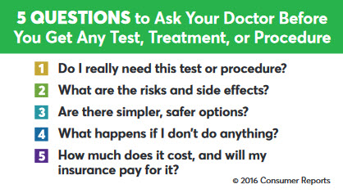
5 Questions to Ask Your Doctor
See page 6 of your workbook.
Notes:
On page 6 of your workbook is a handy wallet-sized card. If you are uncertain of what to ask your doctor at your next appointment, these 5 Questions are a perfect place to start.
In a recent Consumer Reports study, 90-percent of study participants indicated that “they would encourage their family and friends to ask these questions.”
See the link listed in the workbook to download your own copy for printing.

Slide 14
When You See a Specialist
Know the difference between a Primary Care Provider and a Specialist (see page 6.)
Make sure the specialist has all test results and records on your case
Make sure you know why the tests are being done
Ask: Are these tests necessary?
Don’t repeat tests!
See the If You Are Referred to a Specialist checklist on page 6 of your workbook.
Notes:
Page 6 … [read through the slide.]

Slide 15
If You Are Facing Surgery
Most surgeries are not emergencies.
This means that you have time to make sure that this surgery is the best treatment for you.
Tell your provider that you want to be an active partner in your health care.
Consider the risks and benefits.
See the Shared Medical Decisions About Surgery questions on page 7 of your workbook.
Notes:
If you are facing surgery, most operations are not emergencies and are considered elective surgery. This means that you have time to learn about your operation to be sure it is the best treatment for you. You also have time to work with your surgeon to make the surgery as safe as possible.
Page 7 in the workbook offers some questions to ask your provider when you are told that you need surgery and questions that weigh the risks and benefits of having a surgery. Thoroughly consider the risks and the benefits. To choose the best anesthetic (regional, general, spinal, or local), speak with the anesthesiologist. During your pre-operative visit, you will have a chance to meet the anesthesiologist and discuss your expectations and risks in order to determine what will be most appropriate to meet your needs.
You may also want to find another surgeon to get a second opinion, to confirm if surgery is the right treatment for you. You might want to ask friends or coworkers for the names of surgeons they have used. Make sure all pertinent medical records are available for the second opinion. The Alliance gives you a wide network of medical provider choices. The doctor you choose may be a part of the same health system as your Primary Care Provider or may be part of a different health care system. Later in the presentation, we’ll talk about our Find a Doctor website tool that you can use to find an in-network doctor. We also have flyers available to assist you with the paperwork if you choose a doctor in a different health care system than your previous doctor or current Primary Care Provider. [Bring “Switching Doctors” flyer to presentation.]

Slide 16
How to Get Your Money’s Worth at Each Health Care Visit
Notes:
How can you get your money’s worth at each health care visit? Here’s how …

Slide 17
Considering the Cost of Health Care
Cost can vary wildly, even between nearby locations.
You could pay more for the exact same type of care depending on which hospital you choose.
What you pay is not related to the quality of your care.
High-quality care doesn’t necessarily cost more.
The Alliance is here to help you:
Save by staying in-network
www.the-alliance.org and click on “Find a Doctor.”
Contact Customer Service for a procedure cost estimate.
Notes:
Sometimes high-quality care is less expensive.
Sometimes low-quality care is the most expensive.
[Talk about the “considering the cost of health care” section on page 7.]

Slide 18
The Cost Might Vary More Than You Think
Here are some cost estimate options. There can be a wide variation in cost, even for the same procedure at a location just down the street.
Sources: The Alliance Customer Service Dept.; www.google.com/maps 7/16/18
Notes:
Turn to page 7. The Cost Might Vary More Than You Think
Here’s 5 cost estimates for a consumer who lives in Madison, Wis. There’s almost $8,000 difference in cost between the highest and lowest in-network options shown.
Cost variation happens everywhere. Here’s a cost estimate for a consumer who lives in Rockford, Ill. All of the options shown are in-network. Know before you make an appointment. Contact Customer Service for a cost estimate. We are here to help.

Slide 19
Three Ways to Spend Less & Find Quality Care with
# 1
Save by Staying In-Network
Look for the Symbols and Adjust the Filters
Check the Cost Before Making an Appointment
# 2
# 3
Notes:
See page 8 for our Network Coverage Map. Here’s where our network of providers are located now – and we’re constantly expanding!
Use The Alliance’s Find a Doctor online tool to choose a doctor or facility that is in-network.
See page 9. Three Ways to Spend Less and Find Quality Care with Find a Doctor. [Read through the “3 Ways.”]

Slide 20
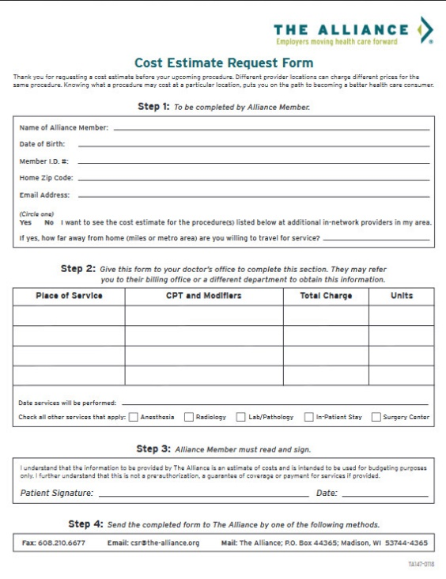
We Are Here For You
www.the-alliance.org
Click on “Individuals and Families” for more better health care consumer tips.
Have Questions? Want a Cost Estimate? Contact Customer Service
Customer Service is available Monday – Friday 8:30 a.m. to 4:30 p.m.
800.223.4139
csr@the-alliance.org
Download a cost estimate request form from our website at:
www.the-alliance.org/customer-service
Notes:
When you go to The Alliance website, you’ll find even more tips to be a better health care consumer.
You’ll find a patient safety toolkit, a diabetes toolkit, ways to avoid facility fees, pregnancy resources, gym discounts and more.
Also, when you go to our Customer Service webpage, www.the-alliance.org/customer-service you can download a cost estimate request form.

Slide 21
Thank you for attending!
The #1 way to make sure you get safe, quality health care and reduce your costs is to …
Be an active participant and share in your medical decisions.
Notes:
Thank you for attending this presentation on becoming a better health care consumer. Please take home your workbook and share with your family.

