Slide 1

RAND Hospital Price Transparency Project:
A Briefing for Purchasers

Slide 2
RAND Hospital Price Transparency Project
Briefing for Wisconsin Purchasers
May 13, 2020
Christopher Whaley
This briefing represents the views of the author, and not RAND or RAND’s funders.

Slide 3
Prices Paid by Self-Funded Employers are High
Why private health plans?
  persistently high growth in spending per capita
Why hospitals?
  $1.1T industry
  private prices high, rising, and widely varying

Slide 4
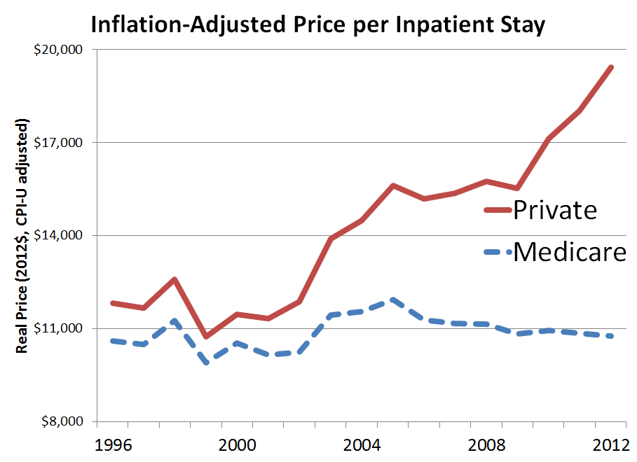
Source: Selden, T. M., Karaca, Z., Keenan, P., White, C., & Kronick, R. (2015). The Growing Difference Between Public And Private Payment Rates For Inpatient Hospital Care. Health Affairs, 34(12), 2147-2150. doi:10.1377/hlthaff.2015.0706.

Slide 5
What Do We Know Already?
Prices paid by private health plans
  higher and growing faster than Medicare
  increases in spending driven by price growth, not utilization
  vary widely from market to market, and from hospital to hospital within markets

Slide 6
What Do We Not Yet Know?
How do prices compare across the country?
Are hospital prices continuing to rise?
Which hospitals/systems are getting the highest prices?
What are the prices that individual self-funded employers are paying and are these prices in line with the value that employers are getting?

Slide 7
Hospital Prices in COVID-19 Era
COVID-19 is placing enormous financial pressure on both hospitals and employers
Health benefits are one of the largest expenses for employers
Transparent information about hospital prices is especially important now to ensure employers are getting value

Slide 8
Our Approach
Obtain claims data from
  Self-Funded Employers, APCDs, health plans
Create a public hospital price report
  will be posted online, freely downloadable
  named hospital facilities and systems
  inpatient prices and outpatient prices
Create private hospital price reports for individual self-funded employers
RAND 2.0: Used data from 25 states to compare hospital prices

Slide 9
Relative prices varied considerably across the states studied
Non-Medicare Prices Paid to Hospitals, by State, 2017
300%
200%
Percent of Medicare Price in That State
100%
Michigan: 156%
Indiana: 311%
0
RAND proprietary — Do not cite or distribute
Notes:
Will delete separate points for IP
Source: White, 2019, Prices Paid to Hospitals by Private Health Plans are High Relative to Medicare and Vary Widely-Findings from an Employer-Led Transparency Initiative
and OP prices
Talk more about hospital responses and what contributes to price variation

Slide 10
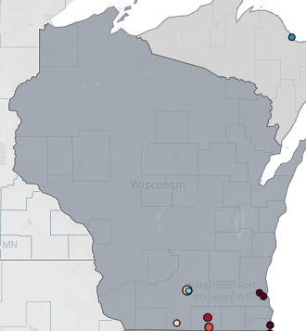
RAND 2.0 Wisconsin Coverage
Only 31 hospitals / providers included last year
Not great geographic coverage
Limited data to inform employer decisions
We can do better!

Slide 11
RAND 2.0 vs. RAND 3.0
RAND 2.0
25 states
2 APCDs
Just hospital facility fees
CMS quality scores
Inpatient & Outpatient prices
RAND 3.0
?? States
6 APCDs and expanded self-funded employer participation
Hospital facility & professional
CMS & Leapfrog quality scores
Inpatient, Outpatient, & Service-line prices (e.g. orthopedic surgery)

Slide 12
Timeline for RAND 3.0
September 2019 - June 2020: Collect data from employers, APCDs, and TPAs
March 2020 – August 2020: Analyze data
May 2020: Present results at Employer’s Forum of Indiana Conference
September 2020: Present results
→ Additional time to collect employer data

Slide 13
Study Output 1: Public Report
Uses all data to show national variation in hospital prices
Highlights prices paid by US employers and informs public policies
Free to contribute data
Publicly available in September 2020
https://www.rand.org/pubs/research_reports/RR3033.html

Slide 14
Study Output 2: Private Reports
Use data from individual self-funded employers
Highlight prices paid by specific employers to inform their benefits
$0.20 per covered life (up to $15,000 and min of $1,000)
  RWJF requirement
Released as available

Slide 15
High-Level Private Report Summary
Savings if employer paid:
Employer X amount paid | Medicare amount paid | Relative price paid by Employer X | 1X Medicare | 1.5X Medicare | 2X Medicare
$21,721,398 | $7,438,329 | 2.92X | $14,283,069 | $10,563,905 | $6,844,740

Slide 16
RAND 3.0 Overview

Slide 17
How do we compare hospital prices?

Slide 18
Comparing Prices is Challenging
Every hospital is different and performs different services
No “apples-to-apples” comparisons
Medicare system can help us standardize
Let’s make an apple pie, but two recipes!

Slide 19
Recipe 1: Percent of Medicare
How much more do employers pay than Medicare would have paid at exact same hospitals?
Pros: Easy to interpret and compare across hospitals
Medicare adjusts for cost of living and wage differences
Cons: Medicare pays teaching and DSH hospitals more, and so benchmarking against Medicare will make them look cheaper

Slide 20
Recipe 2: Standardized Prices
Medicare has figured out how much more to pay for different services
  E.g. Medicare pays 34.65 times for a heart transplant (DRG 103) vs. chest pains (DRG 143)
  We can use these weights to make an apples-to-apples comparison across hospital services
  Average ”walk out the door” amount
Pros: Can put everything into one number
Don’t have to worry about teaching/DSH/etc. payments
Cons: Different systems for inpatient vs. outpatient
No comparison to Medicare benchmark
Maybe we want to account for higher teaching/DSH/etc. payments?

Slide 21
Why Compare to Medicare?
Largest purchaser of health care in the world
Sets industry standards
Prices and methods are empirically based and transparent
Medicare prices intended to be fair
Uses quality measures/value-based payment

Slide 22
Data Protections
Project regulated by RAND Human Subjects Protection Committee
Data analysis conducted on secure computing environment
Similar environment used to analyze confidential Medicare data
Data analysts undergo HIPAA and human subjects training
NDAs and DUAs in place to protect data confidentiality

Slide 23
How Have Employers Used RAND 2.0
(and how can they use 3.0)?
Finally have information about prices
Change hospital networks
Benchmark Prices

Slide 24
Employers are collecting information about prices
Colorado Business Group on Health used RAND 2.0 data to produce report on value of Colorado hospitals
Proposed options for Colorado employers to address prices in their specific markets

Slide 25
Employers are using data to benchmark prices

Slide 26
Employers are using RAND 2.0 in their negotiations
Anthem is attempting to support a core goal of the RAND study by holding hospital systems accountable for their prices, which in turn will benefit our employees' mental and physical health and their financial wellness.
—Purdue Senior Director of Benefits

Slide 27
RAND 3.0 Participation

Slide 28
How Can Employers Participate in RAND 3.0
FAQ here: https://www.rand.org/health-care/projects/price-transparency/hospital-pricing/round3/faq.html (will be sent out!)
Employers need to authorize insurance carrier, TPA, or data warehouse to send claims data to RAND

Slide 29
Master DUA Agreements
RAND has “Master DUAs” with Anthem, Cigna, and United
  Hoping to do the same with Aetna
  Employer has to email account rep authorizing data transfer
UHC / UMR is charging all employers $1,200 to $2,500 data transfer fee
Cigna is charging at least 1 employer ~ $1,500 fee

Slide 30
Sometimes Data Warehouse is Easier
If employer has multiple TPAs, warehouse can provide all at once
IBM Watson
  Simple 2 page data agreement
  Employer, IBM, and RAND sign
  Transfers have proven successful

Slide 31
Thank you!
Please reach out with any questions
Contact information: cwhaley@rand.org

Slide 32

Call to Action

Slide 33

Wisconsin Health Information Organization (WHIO)
Mission: To improve the quality, safety and efficiency of the health care delivery system in Wisconsin.
Vision: To be an indispensable information resource to those who work to improve health & the value of healthcare in Wisconsin.
Voluntary, statewide, 501(c)(3) public-private collaboration governed by a multi-stakeholder Board of Directors consisting of providers, payers, purchasers and State agencies.
Largest source of Wisconsin data and information with about 4.2 Million insured lives, 125 Million claims and over $100 billion in charges.
Notes:
The foundation of who WHIO is is not changing.

Slide 34
Benefits of WHIO to Employers
WHIO information spans the continuum of care, including all:
  Settings: inpatient, emergency department, ambulatory surgery center, clinic, nursing home, home health, hospice
  Services: pharmacy, laboratory, radiology, durable medical equipment
  Professionals: physicians, nurse practitioners, physician assistants, psychologist, OT/PT/ST, chiropractors, etc.
WHIO is an independent data resource
  Insights to improve health and health care – improve quality; lower the price
  Available to all organizations
Self-funded employers can contribute their data to WHIO

Slide 35
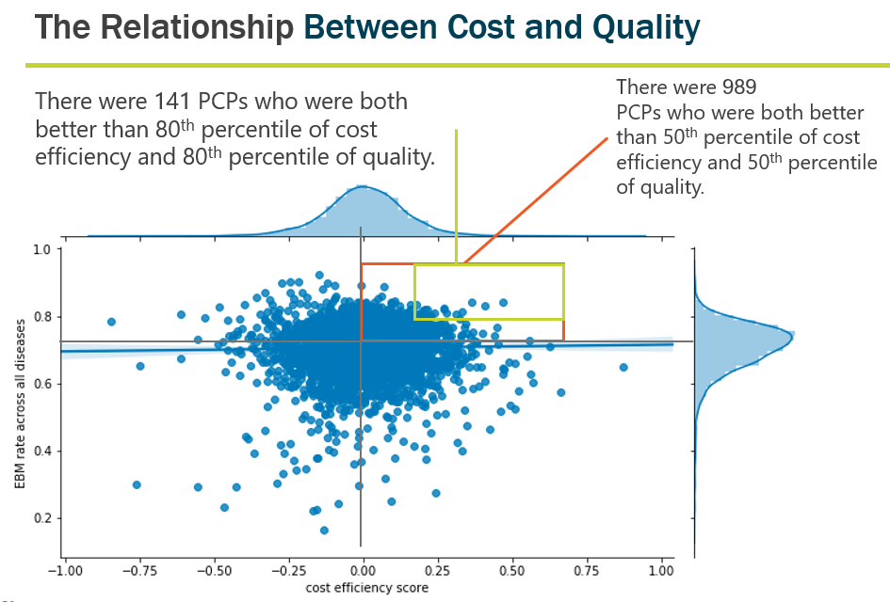
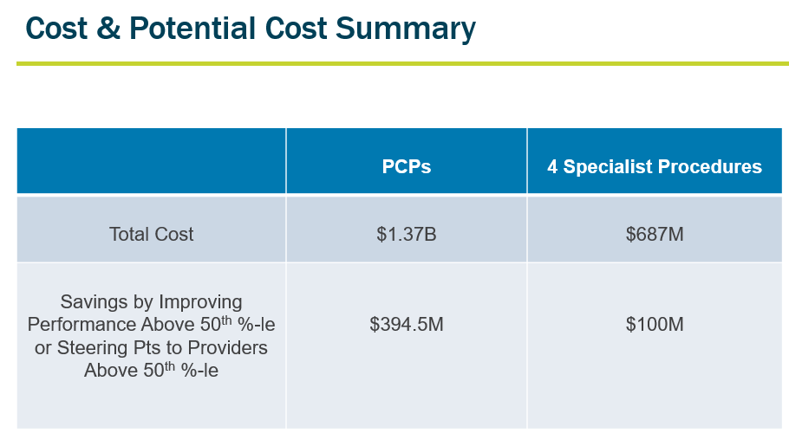
Physician Value Report
Top priority for employers: purchase high value health care
Purpose: evaluate the value of care by physicians throughout WI
  Funded by BHCG and the Greater Milwaukee Business Foundation on Health
  GNS Healthcare – leading provider of artificial intelligence applications in health care
  Using claims data from Wisconsin Health Information Organization (WHIO) – the largest source of health care information in the state representing 4.2 million covered lives
  Goals:
    Support health system performance improvement
    Inform employer benefit design for better health care decision-making

