Slide 1
COVID-19 Vaccination Management for Employers
February 24, 2021

Slide 2
Today’s Agenda of Panelists
9:00 – 9:05 Jeff Kluever
Executive Director, Business Health Care Group Welcome & Opening Remarks
9:05 – 9:35 Jon Meiman, MD
Chief Medical Officer and State Epidemiologist for Environmental and Occupational Health, Wisconsin Department of Health Services
Stephanie Schauer, PhD
Immunization Program Manager, Wisconsin Division of Public Health
9:35 – 10:10 Lindsey Davis
Partner, Labor & Employment & Practice Group, Quarles & Brady LLP
10:10– 10:20 Jim Sheeran
Director, Corporate Benefits, Molson Coors Beverage Company
10:20 – 10:40 Margaret Hennessy, MD
Medical Director, Ascension Medical Group Wisconsin & Physician Leader, Ascension Wisconsin COVID-19 Vaccine Operational Planning Team
10:40 – 11:00 Cheryl DeMars
CEO, The Alliance
Questions & Closing Remarks

Slide 3
Jon Meiman, MD
Chief Medical Officer and State Epidemiologist for Environmental and Occupational Health
Wisconsin Department of Health Services
Stephanie Schauer, PhD
Immunization Program Manager
Wisconsin Division of Public Health

Slide 4
COVID-19 vaccination information for employers
Division of Public Health
Wisconsin Department of Health Services
Jonathan Meiman, MD
DHS Chief Medical Officer
Stephanie Schauer, PhD
Immunization Program Manager

Slide 5
OVERVIEW of today’s talk
January 15, 2021 webinar provided overview of COVID-19 workplace safety
Today’s webinar will focus on vaccines
Part 1 (Schauer): Vaccine updates
Part 2 (Meiman): Employer considerations during workforce vaccination

Slide 6
Vaccine Updates

Slide 7
Currently Authorized Vaccines
There are currently 2 vaccines which have received Emergency Use Authorization (EUA)
Pfizer BioNTech
Moderna
mRNA vaccines
Require two doses for full protection
Pfizer, 21 days apart
Moderna, 28 days apart

Slide 8
Currently Authorized Vaccines
Johnson and Johnson (Janssen) has submitted an application for EUA
Will be reviewed by FDA on February 26
Only a single dose is needed
If authorized, the vaccine could be available in early March, but likely the number of doses available will be limited initially

Slide 9
What are mRNA vaccines?
They carry genetic material that teaches our cells how to make a harmless piece of “spike protein,” which is found on the surface of the COVID-19 virus.
Cells display this piece of spike protein on their surface, and an immune response is triggered inside our bodies.
This produces antibodies to protect us from getting infected if the SARS-CoV-2 virus enters our bodies.

Slide 10
Facts about mRNA vaccines
Genetic material from the vaccine is destroyed by our cells once copies of the spike protein are made and it is no longer needed.
They do not affect our DNA; mRNA does not enter the cell nucleus.
mRNA vaccines are faster to produce than older technology vaccines.

Slide 11
What vaccine side effects can I expect?
The common side effects include: fever, chills, body aches, and soreness at the injection site.
It is normal to have these, and is a sign that your body is building protection to the virus.
Most side effects go away in a few days. The likelihood of a severe side effect is less than 0.5%.
Some individuals are reporting more side effects after the second dose or if they have had COVID-19 disease.

Slide 12
Emergency Use Authorization
Vaccine approval is driven by science
The vaccines are going through all same steps in the trial phases that all vaccines go through for full FDA licensure
The vaccines were tested in large clinical trials to make sure they met safety and efficacy standards.
Thousands of people of different ages, races, ethnicities and medical conditions were recruited to participate in the trials.
The vaccines continue to be monitored through a variety of systems.

Slide 13
How do we know the vaccines are safe?
CDC and FDA continuously track the safety of vaccines after they get authorized or approved.
These systems have been around for a long time:
Vaccine Adverse Event Reporting System (VAERS)
Vaccine Safety Datalink (VSD)
Clinical Immunization Safety Assessment (CISA)
Biologics Effectiveness and Safety System (BEST)
CDC also added v-safe, a new smartphone-based health checker, to make it even easier for people to report any health problems after they get their COVID-19 vaccines.

Slide 14
Eligible Groups

Slide 15
Currently Eligible
Next Eligible
Began 12/14/2020
Future
Frontline health care personnel (who provide direct patient care with patients who can transmit SARS-CoV2 and/or infectious materials)
Residents and staff in skilled nursing and long-term care facilities (incl. Skilled Nursing Facilities & Assisted Living Facilities)
Starting 3/1/2021
Educators (incl. childcare and higher ed.)
Individuals enrolled in Medicaid LTC programs (IRIS, FC, Katie Beckett and Children’s LTC Waiver)
Mink husbandry
Public-facing essential workers (incl. 911, utility, public transit, food chain)
Non-frontline health care personnel
People who live in congregate settings (incl. including shelters, supported and transitional housing, employer-provided housing, & correctional institutions)
To be determined
Other essential workers
People with high-risk medical conditions
To be determined
General Public
Began 1/18/2021
Police and fire personnel, correctional staff
Began 1/25/2021
Adults ages 65 and over

Slide 16
Educators and Child Care
All staff in regulated childcare, public and private school programs, out-of-school time programs, virtual learning support, and community learning center programs.
All staff in Boys and Girls Clubs and YMCAs.
All staff in preschool and Head Start through K-12 education settings.
Faculty and staff in higher education settings who have direct student contact.

Slide 17
Public-Facing Essential Workers
9-1-1 operators
Utility and Communications Infrastructure:
Workers who cannot socially distance and are responsible for the fundamental processes and facilities that ensure electric, natural gas, steam, water, wastewater, internet, and telecommunications services are built, maintained, generated, distributed, and delivered to customers.

Slide 18
Public-Facing Essential Workers
Public Transit
Drivers who have frequent close contact with members of the public, limited to:
Public and commercial intercity bus transportation services.
Municipal public transit services.
Those employed by specialized transit services for seniors, disabled persons, and low-income persons.

Slide 19
Public-Facing Essential Workers
Food Supply Chain:
Agriculture production workers, such as farm owners and other farm employees.
Critical workers who provide on-site support to multiple agricultural operations, such as livestock breeding and insemination providers, farm labor contractors, crop support providers, and livestock veterinarians.
Food production workers, such as dairy plant employees, fruit and vegetable processing plant employees, and animal slaughtering and processing employees.

Slide 20
Public-Facing Essential Workers
Food Supply Chain (cont):
Retail food workers, such as employees at grocery stores, convenience stores, and gas stations that also sell groceries.
Hunger relief personnel, including people involved in charitable food distribution, community food and housing providers, social services employees who are involved in food distribution, and emergency relief workers.

Slide 21
Non-Frontline Essential Health Care Personnel
Personnel who are not involved in direct patient care but are essential for health system infrastructure. These staff are often affiliated with hospitals. Non-hospital employee and non-frontline employees employed by health systems are also included.
Categories of non-frontline essential health care personnel include:
Public health
Emergency management
Cyber security
Health care critical supply chain functions, including the production, manufacturing, and distribution of vaccine.
Support roles

Slide 22
Congregate Living Facility Staff and Residents
Staff and residents of congregate living facilities.
Some settings in this group may be non-voluntary or provide services to marginalized populations – meaning residents do not have the resources or choice to mitigate exposure.

Slide 23
Prioritization
Vaccine providers are strongly encouraged to continue with currently eligible populations (e.g. individuals 65 years and older, unaffiliated healthcare providers)
Of the March 1st eligible groups: Educators and childcare staff are the priority
It will take time to get everyone in the newly eligible groups vaccinated and will depend on vaccine supply from the federal government.

Slide 24
Congregate Living Facility Staff and Residents (cont)
Shelters: Shelter provided to those who are homeless and/or in need of protection (e.g., domestic violence shelters).
Transitional housing: A project that is designed to provide housing and appropriate supportive services to homeless persons to facilitate movement to independent living when such facilities include shared bedrooms.
Incarcerated individuals: Individuals in jails, prisons, and mental health institutes.

Slide 25
Vaccinating March 1 Eligible Groups
Vaccination of March 1st eligible populations will be supported by
Local and Tribal Health Departments (LTHD)
pharmacy partners
hospitals and clinics
employers
home health agencies/community and commercial vaccinators
through State and Federal assistance in the form of
community-based vaccination clinics
mobile vaccination teams
LTHD are coordinating efforts in local jurisdictions.

Slide 26
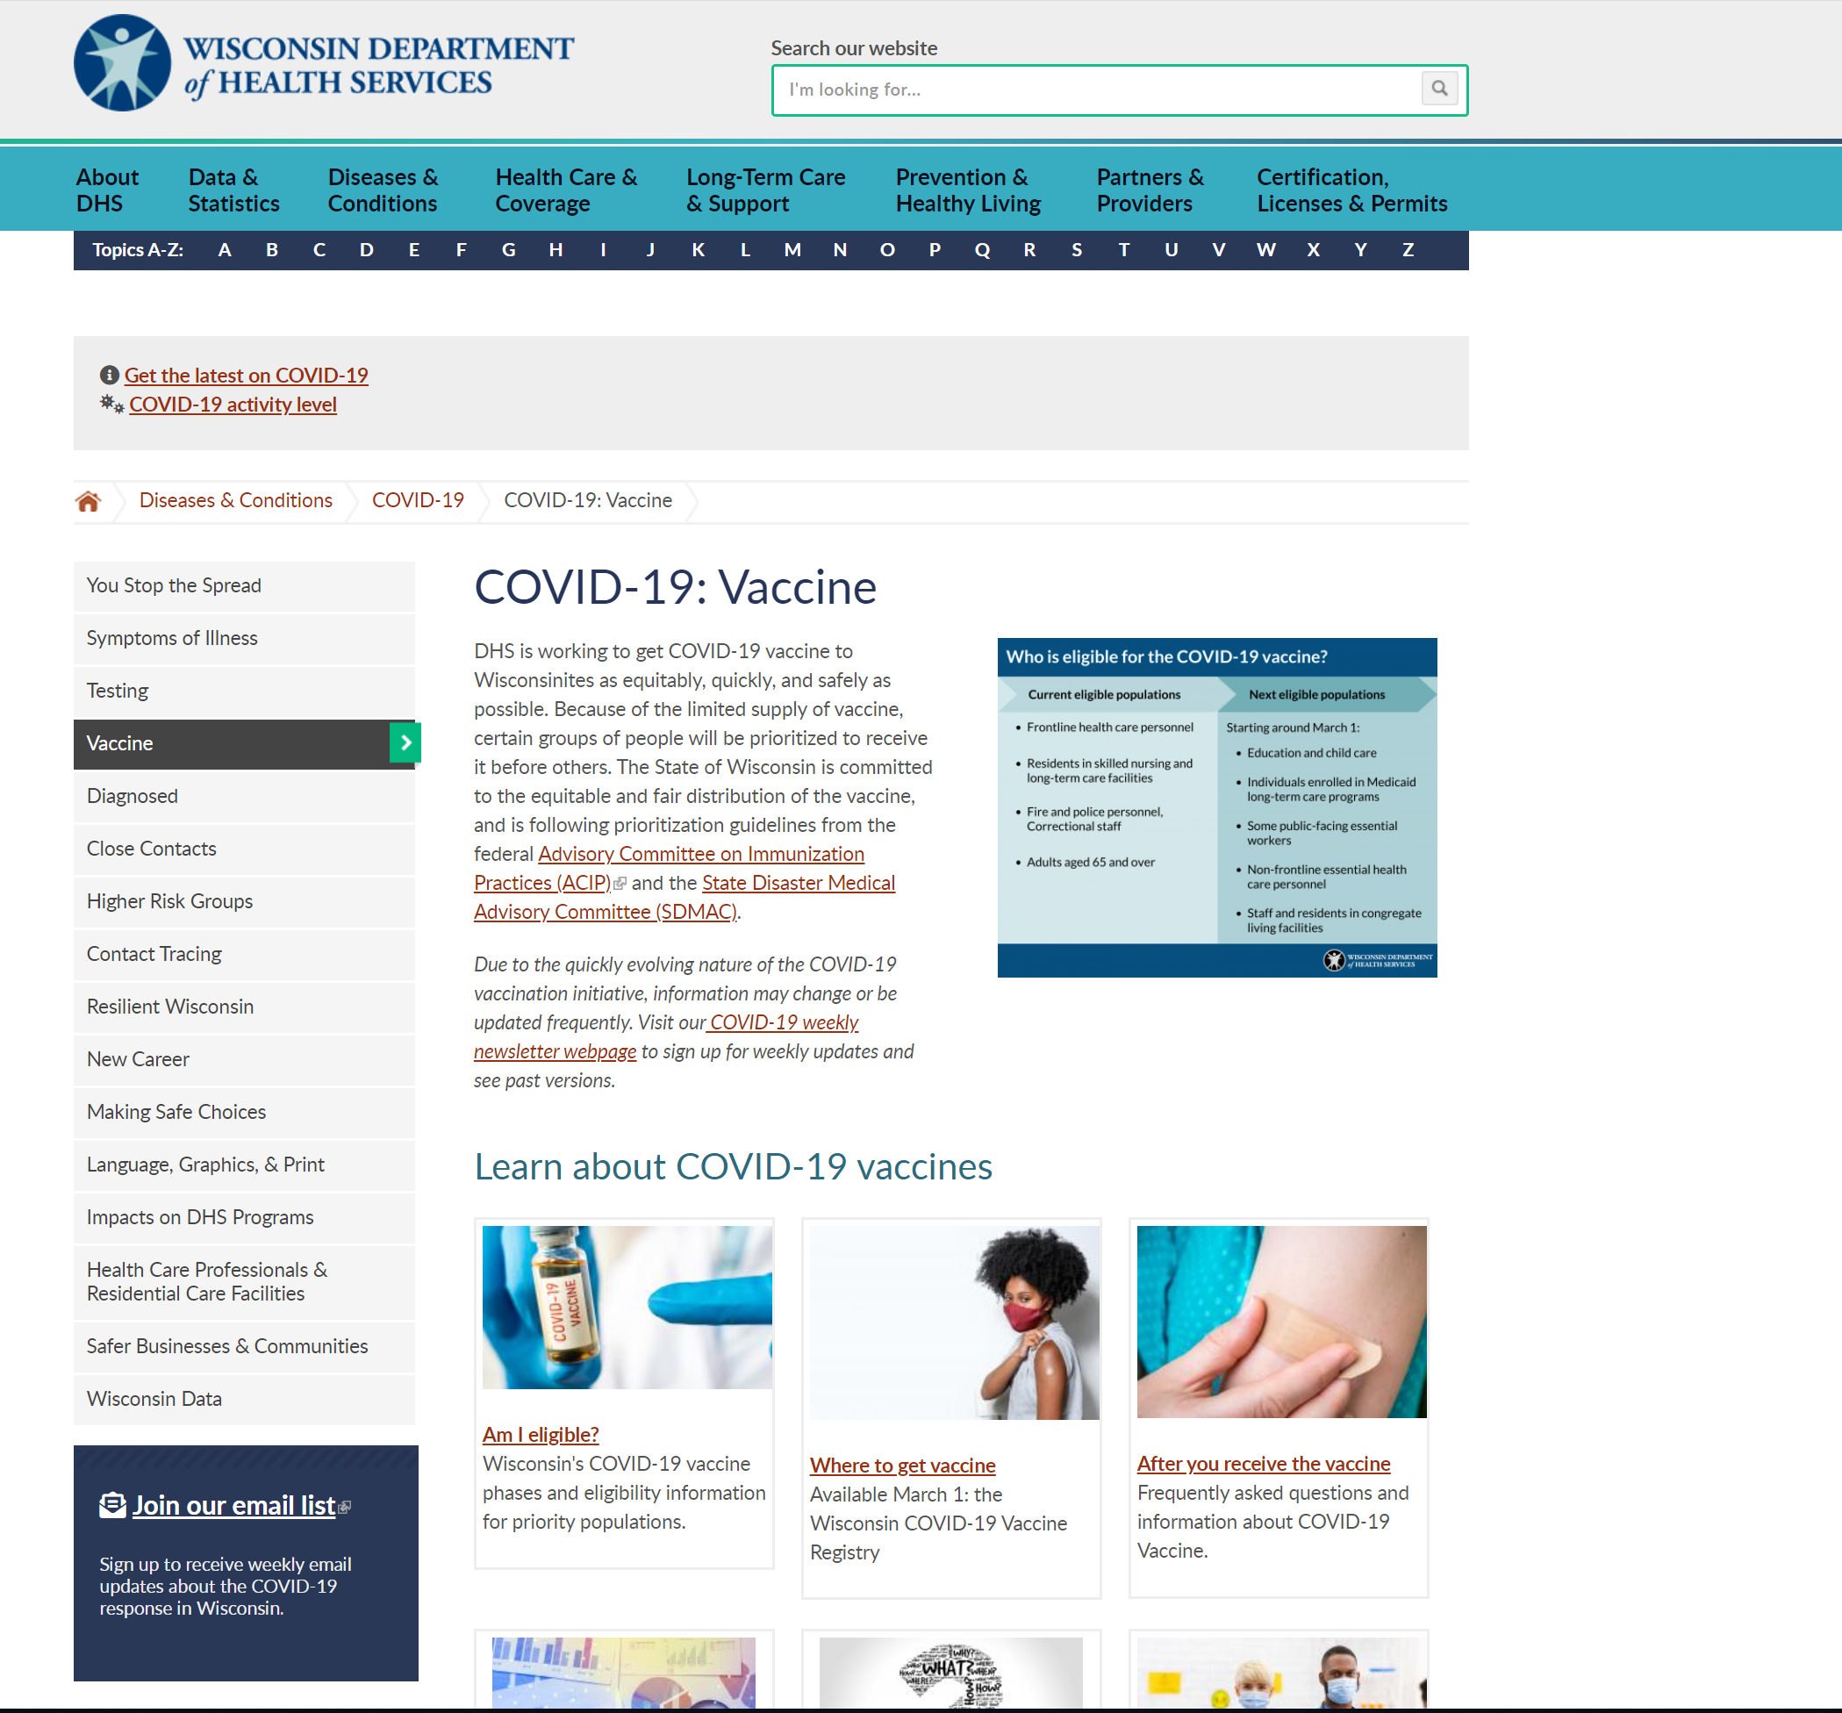
Website Resources
https://www.dhs.wisconsin.gov/covid-19/vaccine.htm

Slide 27
Part 2: workforce vaccination

Slide 28
Vaccinating the workforce
How are Wisconsin employers approaching vaccination?
What can employers do to encourage vaccination among workers?
What are the practical considerations of workforce vaccination?

Slide 29
Wedc/dhs employer survey
Anonymous online survey conducted through publicly accessible link
January 19 – February 05
4,451 respondents
% respondents - top 5 industry sectors
% respondents - by workplace size

Slide 30
Wedc/dhs employer survey
Employer views on importance of workforce vaccination

Slide 31
Wedc/dhs employer survey
Role of employers in vaccination

Slide 32
Wedc/dhs employer survey
Percent of workforce willing to be vaccinated
(of employers who conducted worker surveys, n=859)

Slide 33
Wedc/dhs employer survey
Major drivers of vaccine hesitancy

Slide 34
Wedc/dhs employer survey
Trusted messengers, according to employers:
Local healthcare providers
DHS / CDC / Local public health
Company management

Slide 35
Encouraging vaccination
What can employers do to encourage vaccination?
Provide education
Reduce barriers
Consider incentives

Slide 36
Encouraging vaccination
Education
Utilize trusted messengers

Slide 37
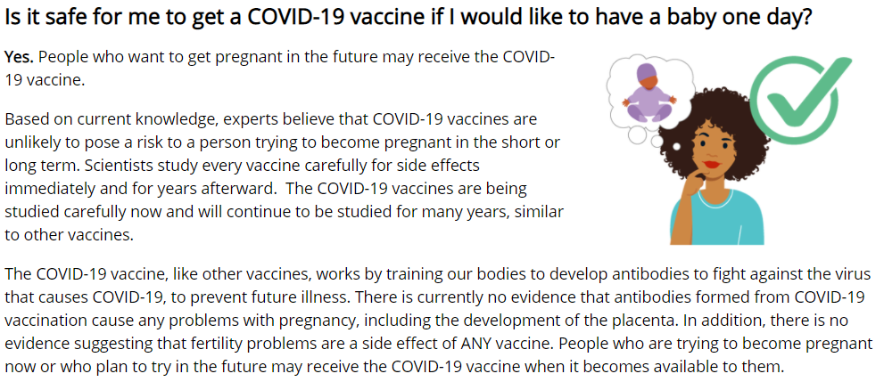
Encouraging vaccination
Education
Utilize trusted messengers
Address vaccine efficacy and safety
https://www.cdc.gov/coronavirus/2019-ncov/vaccines/facts.html

Slide 38
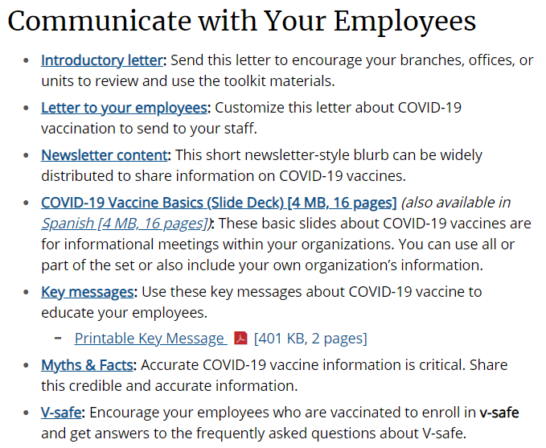
Encouraging vaccination
Education
Utilize trusted messengers
Address vaccine efficacy and safety
Use multiple channels (reading level, language)
https://www.cdc.gov/coronavirus/2019-ncov/vaccines/toolkits/essential-workers.html

Slide 39
Encouraging vaccination
Reducing barriers
Support paid leave for COVID-19 vaccination in the community
Support paid leave for employees with side effects
Employer-sponsored vaccine clinics

Slide 40
Encouraging vaccination
Providing incentives
https://www.cnn.com/2021/02/21/business/store-chain-workers-covid-vaccine/index.html

Slide 41
Encouraging vaccination
Providing incentives
Large body of scientific literature on vaccine incentives
Randomized controlled trial* of >12,000 workers:
Incentive + education most effective for increasing flu vaccination
Meta-analysis of influenza vaccination studies**
Incentives reduce unvaccinated healthcare workers ~30%
* Nowalk MP, Lin CJ, Toback SL, Rousculp MD, Eby C, Raymund M, Zimmerman RK. Improving influenza vaccination rates in the workplace: a randomized trial. Am J Prev Med. 2010 Mar;38(3):237-46. doi: 10.1016/j.amepre.2009.11.011. Epub 2009 Dec 24. PMID: 20036102.
** Siemieniuk R, Coleman B, Shafiz S, Al-Den A, Bornsten S, Kean R, McGeer A, Goodliffe L. Interventions to increase healthcare worker influenza vaccination: a meta-analysis. Poster ID1713 presented at the IDWeek2014. Advancing Science, Improving Care.

Slide 42
Practical considerations
What are the practical considerations of workforce vaccination?
Vaccine side effects
Staggering vaccination
Quarantine for vaccinated workers
Continuing workplace safety measures

Slide 43
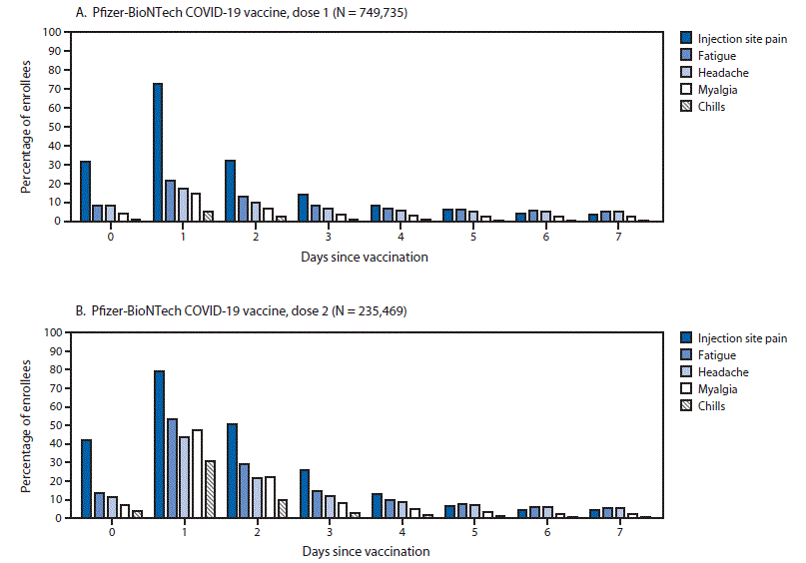
Practical considerations
Side effects are usually short-lived and minor
Symptoms quickly subside after day 2
Fever or fatigue, on occasion, may result in lost work time
Pfizer 1st dose
Pfizer 2nd dose
https://www.cdc.gov/mmwr/volumes/70/wr/mm7008e3.htm?s_cid=mm7008e3_w

Slide 44
Practical considerations
Returning to work when side effects occur:
Fever, fatigue, chills, muscle aches
Ideally employees should stay home until being evaluated.
Return to work when fever resolves and employee feels well enough to work
Caution for symptoms that are unlikely to be from vaccine:
Cough, shortness of breath, sore throat, loss of taste/smell
Worker should be tested for COVID-19
https://www.cdc.gov/coronavirus/2019-ncov/downloads/vaccines/toolkits/FAQs-for-Employers_EW-Toolkit_508.pdf

Slide 45
Practical considerations
Staggering vaccination:
Pros:
Avoid possible sick leave of highly essential personnel
Probably more important after 2nd dose of mRNA (Pfizer, Moderna) vaccine
Cons:
Logistically challenging with 2-dose series
Could result in delays vaccinating workforce

Slide 46
Practical considerations
Quarantine after COVID-19 exposure not required if 3 criteria met:
Fully vaccinated
Within 3 months of last dose
No symptoms
2 weeks
3 months
Quarantine not required (if asymptomatic)
Last dose
Fully vaccinated
https://content.govdelivery.com/accounts/WIDHS/bulletins/2c12294
https://www.cdc.gov/vaccines/covid-19/info-by-product/clinical-considerations.html

Slide 47
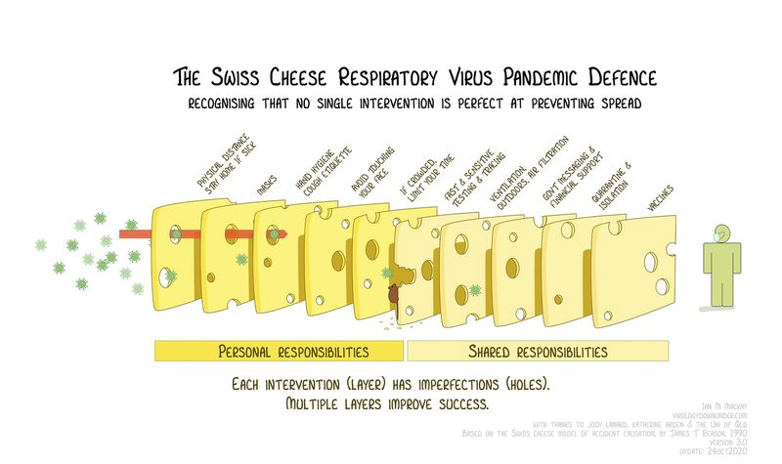
Practical considerations
Maintaining workplace safety protections

Slide 48
Practical considerations
Maintaining workplace safety protections
Employee education
(being safe outside work)
Safe work environment
Managing COVID-19 in the workplace
Vaccination

Slide 49
Practical considerations
Maintaining workplace safety protections
Keep masking, physically distancing, testing, tracing
Safety measures will keep all workers healthy
Need large fraction of the population vaccinated to get back to ‘normal’

Slide 50
Thank you

Slide 51
RESOURCES
https://www.cdc.gov/coronavirus/2019-ncov/vaccines/keythingstoknow.html
https://www.cdc.gov/coronavirus/2019-ncov/vaccines/facts.html
https://www.cdc.gov/coronavirus/2019-ncov/vaccines/toolkits/essential-workers.html

Slide 52
Lindsey Davis
Partner, Labor & Employment Practice Group
Quarles & Brady LLP

Slide 53
Employer Considerations For Selecting A Covid-19 Vaccination Program
Presenter: Lindsey Davis - Partner, Labor & Employment
February 24, 2021

Slide 54
Presenter
Lindsey Davis Partner, Labor & Employment lindsey.davis@quarles.com (414) 277-3073

Slide 55
Agenda
Options for Approaching Vaccination in the Workplace
Compulsory Vaccination Programs
Employer-Encouraged Vaccination Programs
Voluntary Vaccination Programs
Considerations During Vaccination Rollout
Anticipated Issues Following Widespread Vaccination Availability

Slide 56
Compulsory Vaccination Programs
Positives of a Compulsory Vaccination Program
Protect Workplace and Community Health
Reduce Costs of Absences, Lost Productivity, and Long-Run Medical Care
Open and Stay Open
Defend Against Civil Liability
Protect Against Enforcement Action

Slide 57
Compulsory Vaccination Programs cont.
Employers Who Might Consider a Compulsory Vaccination Program
Healthcare Industry
High level of contact between caregivers and patients likely vulnerable to COVID-19
Dining and Hospitality Industry
CDC recommends that businesses close off any areas used by a sick person for 24 hours
Customer-Serving Businesses
Stores may wish to require vaccines to increase likelihood that customers feel comfortable patronizing
Businesses Where Employees Work in Close Proximity
Vaccination may lessen PPE-related friction between employees, and allow employers to eventually relax such requirements
Educational Institutions and Daycares
Teachers and students spend a majority of the day together in enclosed, small learning environments
Travel Industry
Due to high level of interface with the public, vaccination would protect employees and customers

Slide 58
Compulsory Vaccination Programs cont.
Negatives of a Compulsory Employer Vaccination Program
Potential Employer Liability Related to Vaccine
Distrust of Vaccine
Need to Develop an Exemption Process and Consider Accommodations
Disciplining and/or Terminating Employees For Noncompliance
Employers Who Might Not Consider a Compulsory Vaccination Program
Employers with a Union Presence
Employers in Less “High-Risk” Work Environments

Slide 59
Compulsory Vaccination Programs cont.
What To Do Now:
Determine how to track compliance and identify what proof of vaccination will be required
Make a plan to process exemption requests (both medical and religious)
Strategize how to build employee buy-in (including education) and plan for conflict diffusion
Assess how to minimize (and if possible, eliminate) vaccination costs to employees
Anticipate employee time off requests (i.e., related to fatigue and headache after vaccination)
Consider any potential discriminatory impact of a narrowly tailored vaccination requirement (e.g., if vaccines are required only for employees who cannot telework)
Create and communicate a vaccination policy

Slide 60
Employer-Encouraged Vaccination Programs
Positives of an Employer-Encouraged Vaccination Program
Employee Morale and Retention
Administrative Ease
Less Liability Risk for Discrimination Claims
Employers Who Might Consider an Employer-Encouraged Vaccination Program
Workplaces That Do Not Require Close Contact
Workplaces that Can Accommodate Remote Work, But Remote Work Arrangement is Winding Down

Slide 61
Employer-Encouraged Vaccination Programs cont.
Negatives of Employer-Encouraged Vaccination Programs
Voluntary vaccination programs have traditionally had relatively low compliance
Widespread uncertainty and disinformation surrounding COVID-19, and vaccines in particular
Potential that incentives are deemed so enticing that they are coercive and/or discriminatory
Employers Who Might Not Consider an Employer-Encouraged Vaccination Program
May not work well where employees have close contact with members of the public and/or vulnerable populations

Slide 62
Employer-Encouraged Vaccination Programs cont.
What To Do Now:
Do not fully (or perhaps at all) rely upon waivers
Take a thoughtful approach to continued PPE and distancing requirements
Consider "Carrots and Sticks" to encourage inoculation
Create and communicate a vaccination policy

Slide 63
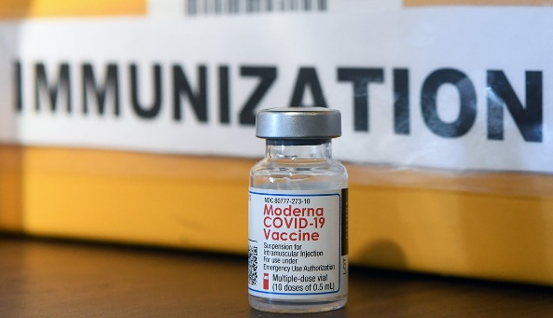
Voluntary Vaccination Programs
Positives of a Purely Voluntary Vaccination Program
Avoids complicating factors associated with other vaccination programs, such as:
Legal Risks
EUA versus FDA licensure
Inquiring about employees' protected status
Offering incentives only to non-protected class
Administrative Costs
Practical Difficulties

Slide 64
Voluntary Vaccination Programs cont.
Employers Who Might Consider a Voluntary Vaccination Program
Industries whose workforces are primarily remote:
Computer and Information Technology
Account/Project Management
Customer Service
Consulting
Marketing
Finance
Employers in compliance with public health guidelines and with no record of workplace outbreaks:
Construction
Transportation/Delivery

Slide 65
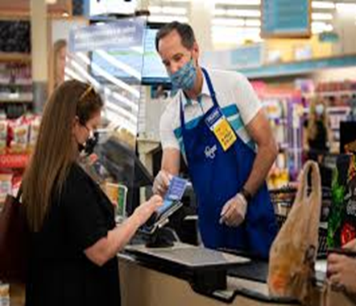
Voluntary Vaccination Programs cont.
Negatives of Voluntary Vaccination Programs
Potential Legal Exposure
OSHA, Tort, or Workers' Compensation Claims
Harmful Business Implications
Diminished Employee Morale and Retention
Employers Who Might Not Consider a Voluntary Vaccination Program
Employers with workforces with high risk of exposure
Healthcare
Education
Emergency Response
Public Transportation
Food Retail

Slide 66
Voluntary Vaccination Programs cont.
What To Do Now:
Distribute educational materials regarding the COVID-19 vaccine
Create and communicate a vaccination policy

Slide 67
Predicting Potential Issues
Vaccination Policy Guinea Pigs:
Healthcare industry
Education sector
Mix of Vaccination Programs
Both mandatory and employer-encouraged
Dependent upon local COVID-19 threat levels
Prioritization of vaccinating persons at higher-risk
Reluctance From Some Employees
CDC Guidance
Strategies to minimize barriers to access (e.g., on-site or mobile clinics)
Messaging and outreach
Use of other COVID-19 safety measures (e.g., masking and distancing)
"Access to vaccination" should not be a condition to reopening

Slide 68
Anticipated Issues Post-Widespread Vaccination Availability
Open Issues:
Full FDA approval of vaccine
Impact of vaccination on infection rates; likely variable by industry and location
The extent to which employers can incentivize the vaccine
How widespread vaccination availability will impact other COVID-19 safety protocols and workplace modifications
Next Steps:
Expect further guidance from the CDC and EEOC
Monitor state and local law and industry-specific and local trends
Remain vigilant and flexible
When in doubt, connect with your local Quarles & Brady attorney

Slide 69
Thank you!
Lindsey Davis Partner, Labor & Employment lindsey.davis@quarles.com (414) 277-3073

Slide 70
Jim Sheeran
Director, Corporate Benefits
Molson Coors Beverage Company

Slide 71
A BHCG Member Employer Perspective
Jim Sheeran
Director, Corporate Benefits
Molson Coors Beverage Company

Slide 72
Molson Coors – Covid-19 Response Framework
Decision Making Framework
Early in the pandemic, the company leveraged its crisis management framework to create a Covid-19 task force. This task force:
Monitors all aspects of the Pandemic with a specific focus on impacts to the business such as company covid-19 cases and quarantines by site, state by state requirements for bars/restaurant openings, brew pub sales of beer onsite, restrictions on office openings, state by state definition of essential workers for vaccine rollout etc.
Keeps the senior leadership informed by 2x weekly meetings and requests approval for key decisions.

Slide 73
Covid-19 Policy Guardrails
Covid-19 policies are guided by company values and our new organizational structure
Put People First
Consistent policies (to the extent possible) across the Americas
Canada
US
Latin America
As essential business we have never shut down our breweries and in deference to that, we tend to prioritize the needs of our operations people over that of non-operational employees

Slide 74
Molson Coors Vaccine Policy
Subject to change!
We are not mandating the vaccine but are encouraging it
No FDA approval (Emergency Use Authorization only)
Not readily available
Ability to maintain social distancing within our operations
Not retail/consumer facing
Inability to have any real consequences in Canada
Company focus on D&I and recognition of cultural/historical differences in various groups receptivity to the vaccine
Overall human resource issues created via mandate
Union relationships

Slide 75
Molson Coors Vaccine Policy
We will not provide special pay for persons getting the vaccine on company time
Already have a very generous PTO policy
Consistent with not mandating the vaccine
We will not provide any special incentives to employees to get the vaccine
Leadership bias against simply paying people
Other incentives considered all created their own set of issues
Wellness program incentives
Extra vacation days
Gift cards, more free beer

Slide 76
Molson Coors Vaccine Policy
We are working to facilitate employee knowledge of the vaccine
Company internet microsite with information (mainly from the CDC) and info on how to register for the vaccine
Leveraging our employee resource groups to specifically target certain groups to provide information and vaccine encouragement through respected and influential leaders
Working with our onsite clinic vendors to acquire the vaccine at our clinics
Employee survey/registration
Lottery system of distribution, prioritizing operational employees
Monitoring state requirements and providing information to the state when requested
Uploading employee name/email address into VAMS (With employee permission)
Working with local health systems and pharmacies to do onsite/near site vaccinations when employees are eligible based on
Will provide employee letters, if appropriate, validating their status as essential workers

Slide 77
Molson Coors Vaccine Pay Policy
Amending Covid-19 leave and Pay Policy to accommodate potential side effects from the vaccine
Employees allowed up to 2 days off post vaccination with pay
Employee must show proof of vaccination
Symptoms must start within 24 hours of vaccination
Applies to both vaccinations
Amending our quarantine process
Employees who show post vaccine symptoms that begin more than 24 hours post vaccination, or last more than 48 hours post vaccine will be treated as possibly covid-19 positive and will fall into our current risk assessment/contact tracing protocols
Employees who are exposed between 15 and 104 days after their second vaccine will not be quarantined

Slide 78
Margaret Hennessy, MD
Medical Director
Ascension Medical Group WI
Physician Leader
Ascension Wisconsin COVID-19 Vaccine Operational Planning Team

Slide 79
Ascension Wisconsin
Associate COVID-19 Vaccination Plan
Presented by: Dr. Margaret Hennessy, MD
Medical Director of Pediatrics for Ascension Medical Group Wisconsin and physician leader on Ascension Wisconsin COVID-19 Vaccine Operational Planning Team, member of the Wisconsin Committee on Immunization Practices

Slide 80
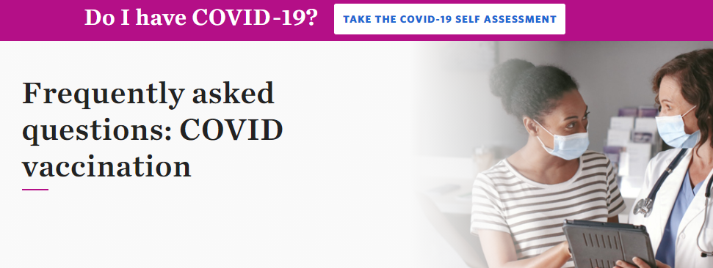
Preparation
Ascension Wisconsin - Associate COVID-19 Vaccination Findings
Established national and local committees to develop workflows
Development of educational material/ resources for different audiences
Operationalizing vaccine clinics

Slide 81
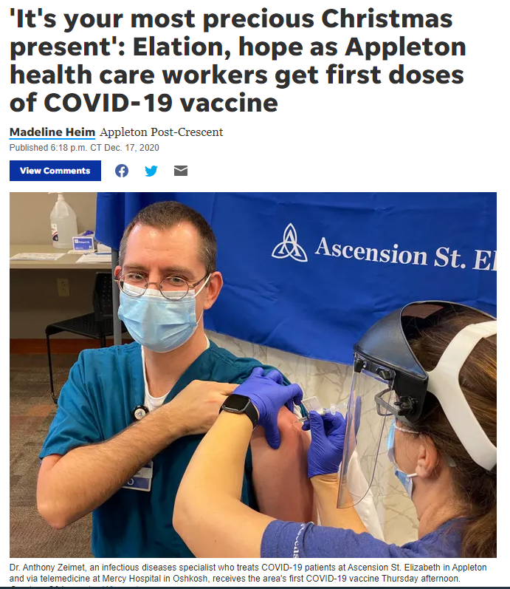
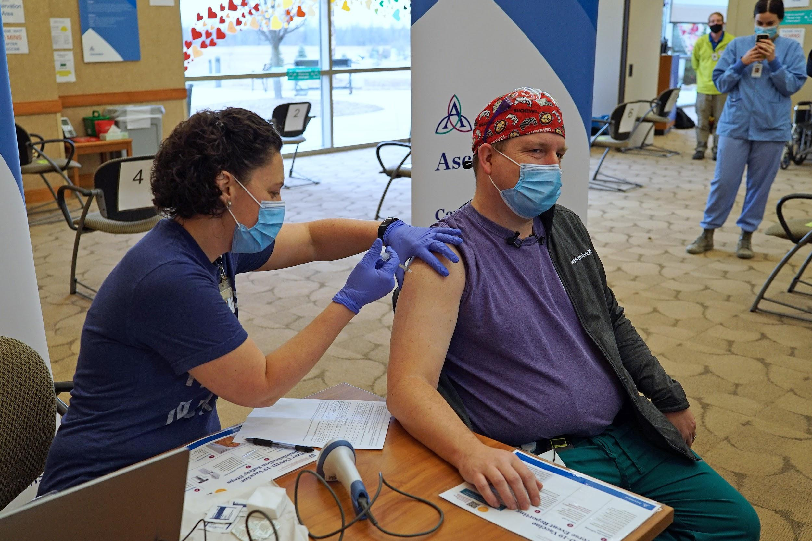
Launch - December 16, 2020
Ascension Wisconsin - Associate COVID-19 Vaccination Findings
“Between Giannis signing the supermax and getting this vaccine today, my Christmas wish list is complete.” - Dr. Joseph Weber, critical care pulmonologist, first Ascension Wisconsin caregiver to receive COVID-19 vaccine.

Slide 82
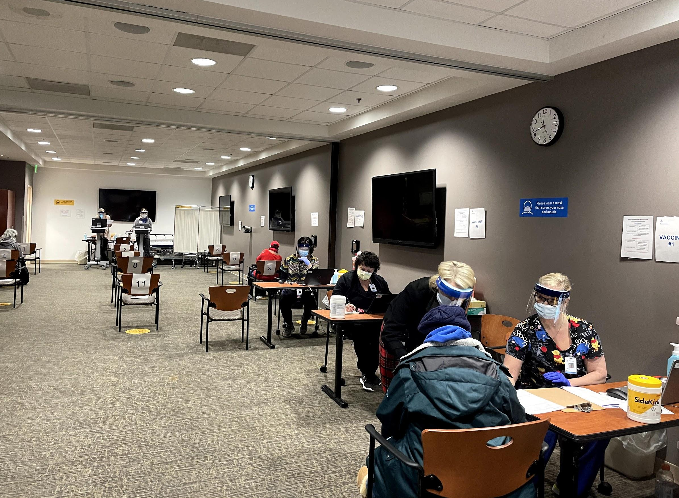
Lessons Learned
Ascension Wisconsin - Associate COVID-19 Vaccination Findings
How to accomplish a successful clinic
Use a scheduling platform for large groups
Organize the right people
Vaccine Manager--RN or higher OR pharmacist
Medical Authority-sign vaccine order, screen for contraindications to vaccine
Medical observer prepared for severe allergic reactions, medical kit, 15-30 minute waiting period
Vaccinators--Medical assistants, RNs, nursing students
Documentation team-enter data into Wisconsin Immunization Registry (WIR)
Have a large space for observation--space individuals 6 feet apart
Use multiple communication channels to reach everyone
Virtual vaccine town halls with subject matter experts, email blasts, text messages, signage in office space / at clinics
Ascension Columbia St. Mary’s Ozaukee patient clinic

Slide 83
Lessons Learned
Ascension Wisconsin - Associate COVID-19 Vaccination Findings
Challenges
Technology challenges--schedule platform, WIR entry
Cold chain maintenance--an issue with current mRNA vaccines
Time limit on vaccine vial-6 hours once vial is opened
Need more people than expected for other vaccine programs like flu clinics
Communications - not everyone checks email, eligibility confusion, scheduling challenges, etc.
Minimize impact to staff schedule (side effects):
Encourage employees to receive vaccine when they have next 1-2 days off
If clinic open 7 days a week, break up unit into groups
Most common side effects: Fever, muscle aches, fatigue, injection site pain--1-2 days
If fever, then not able to work

Slide 84
Employer Advice
Ascension Wisconsin - Associate COVID-19 Vaccination Findings
Lead by example
Educate and empower your employees
Provide reliable and trusted information about COVID-19 vaccines
Sources like WHO, CDC, FDA and Wisconsin DHS
Be transparent
Mitigation strategies are still critical during the vaccine rollout
Maintain safety precautions at your office during vaccine rollout: social distance, masking, hand-washing and disinfection practices

Slide 85
Employer Advice - Educational Resources
Ascension Wisconsin - Associate COVID-19 Vaccination Findings
Ascension - Frequently Asked Questions about COVID-19 Vaccines
CDC - Coronavirus Disease 2019 (COVID-19) Vaccines
CDC - Clinical resources for COVID-19 Vaccines
FDA - FDA COVID-19 Vaccine Information
de Beaumont Foundation - ChangingtheCOVIDConversation.org
FDA - Pfizer-BioNTech COVID-19 Vaccine Fact Sheet
FDA - Pfizer-BioNTech COVID-19 Vaccine EUA Letter of Authorization
FDA - Moderna COVID-19 Vaccine Fact Sheet
FDA - Moderna COVID-19 Vaccine EUA Letter of Authorization
Notes:
LIVE LINKS!

Slide 87
Reducing Vaccine Hesitancy Among Employees Video Resources
The following videos are available from the National Alliance of Healthcare Purchasers Coalition:
COVID-19 VACCINE: Get the Facts
COVID-19 VACCINE: Get the Facts (Spanish translation)
The History of Vaccines
The History of Vaccines (Spanish translation)
Trusting Vaccines
Trusting Vaccines (Spanish translation)

Slide 88
RAND 3.0: Commercial prices relative to Medicare vary widely across states
88

Slide 89
Lend Your Voice – RAND 4.0
Employers
Submit your claims data for RAND 4.0 – easy process
RAND homepage
Contact page to enter your information if interested in submitting data
Hospital Price Transparency Study FAQs
Lend your employer voice to efforts to improve health care value in Wisconsin
Join your regional employer coalitions and encourage other employers to do the same
Engage with other quality and cost transparency initiatives
(e.g.; Wisconsin Health Information Organization; Wisconsin Collaborative for Health Care Quality)
Use the data to:
Reward physicians and hospitals providing high value health care

Slide 90
Questions & Answers
Cheryl DeMars
CEO
The Alliance

Slide 91
Thank You!
Questions?
RAND 3.0 Results – September 24, 2020

