Slide 1
Employee Behavioral Health In a Pandemic
Monday, April 26 | 9:00 am – 10:30 am CST

Slide 2
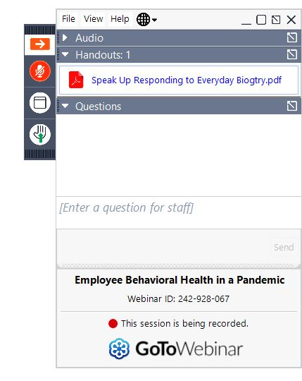
Housekeeping
You'll be muted during the webinar. When unmuted by the host, you'll gain control of your mute status by pressing the mute button below the hand icon.
To access and download the handouts, you can do so by clicking on the “Handouts” dropdown.
To ask a question, please use the Questions box.
If you have any issues during the webinar, please use the question box to communicate with the host.

Slide 3
Agenda
9:00 am
9:10 am
9:45 am
10:25 am
Welcome and Opening Remarks Kyle Monroe
Employee Health in a pandemic Dr. Jerry L. Halverson, Chief Medical Officer, Rogers Behavioral Health
Employer Strategies Panel Julie Norland & Diana Clark
Closing Remarks Melina Kambitsi, Ph.D.

Slide 4
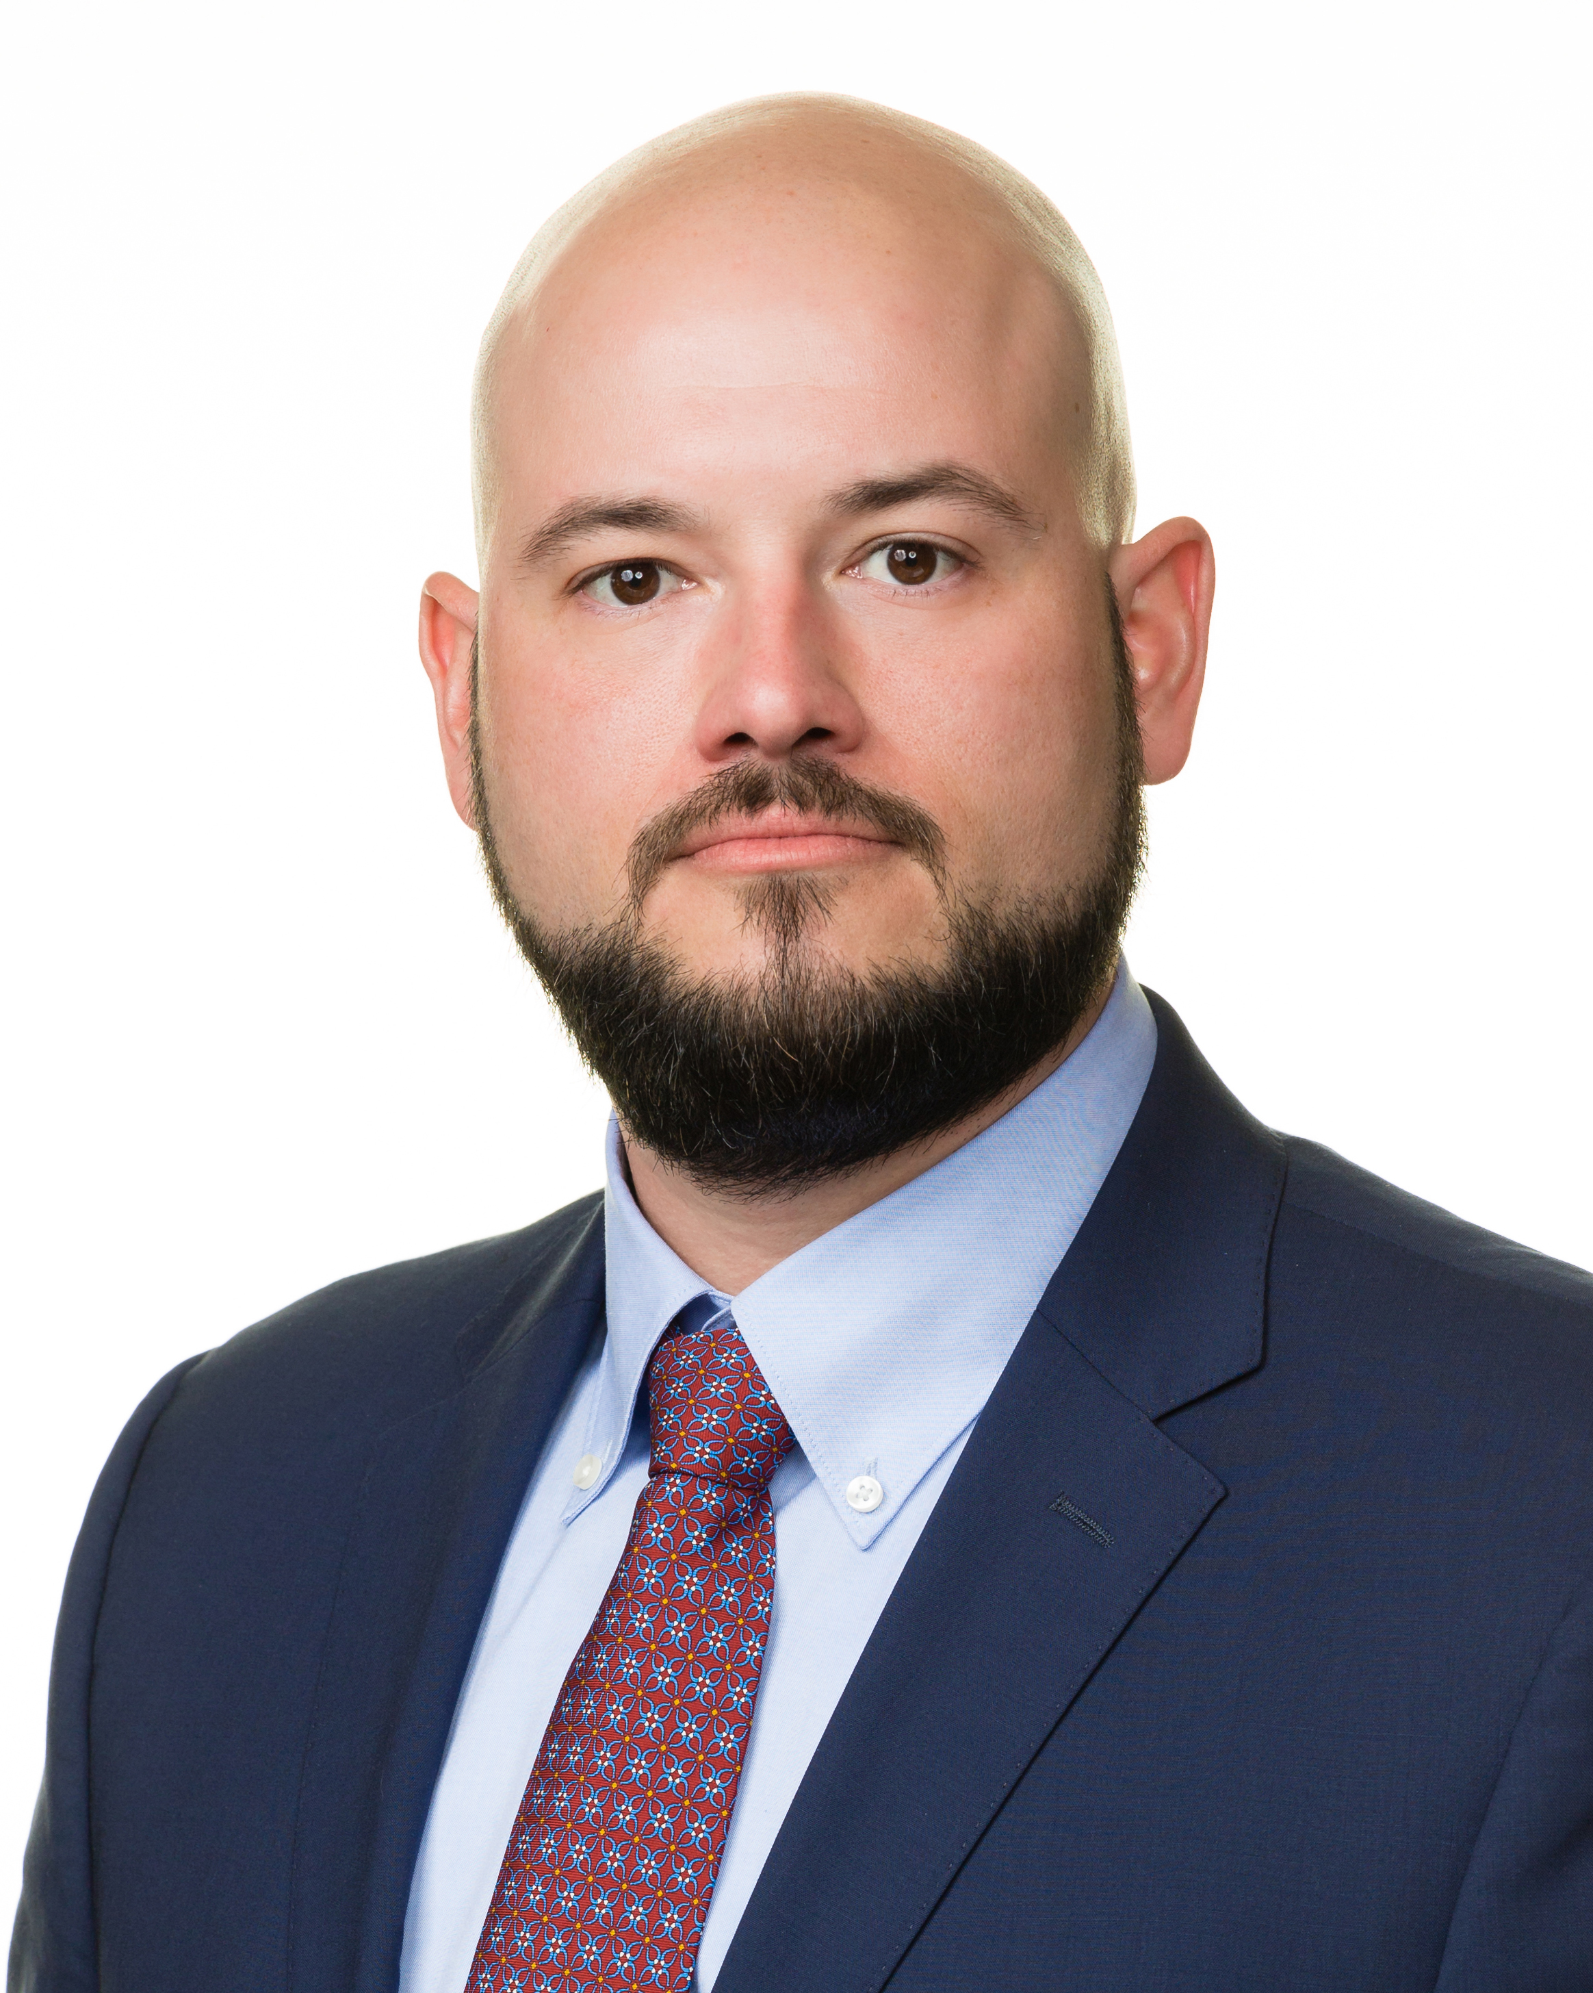
Introduction
Kyle Monroe
Vice President of Network Development & Provider Relations

Slide 5
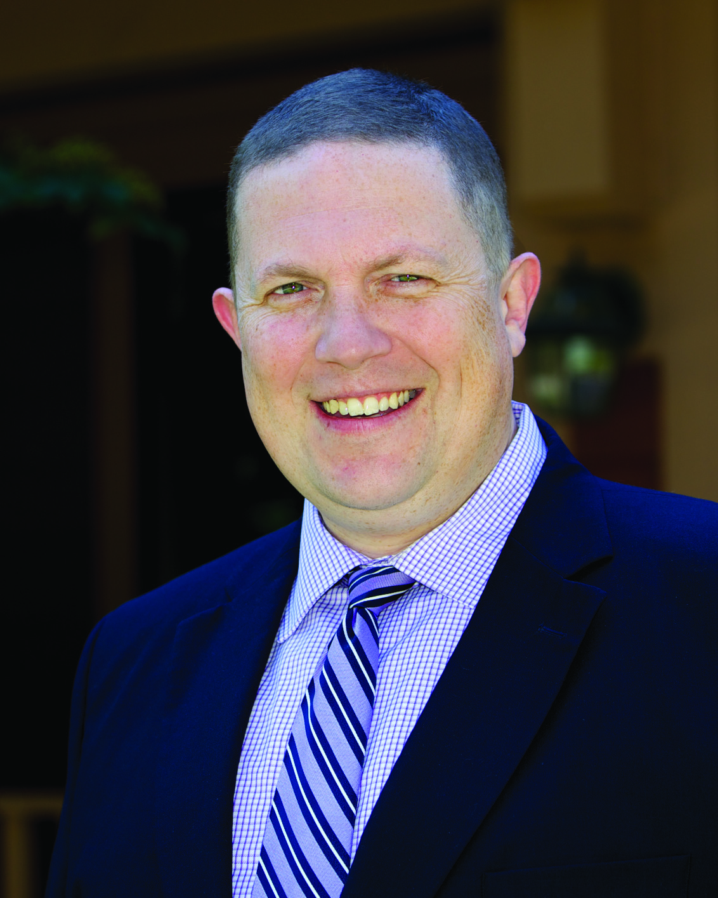
Employee Health in a Pandemic
Dr. Jerry L. Halverson
Chief Medical Officer, Rogers Behavioral Health

Slide 6
Employee Menatal Health in a Pandemic
Jerry Halverson, MD, FACPsych, DFAPA
Chief Medical Officer
Rogers Behavioral Health
April 26, 2021
Notes:
Objective: that people will leave with a greater understanding of these common but debilitating disorders

Slide 7
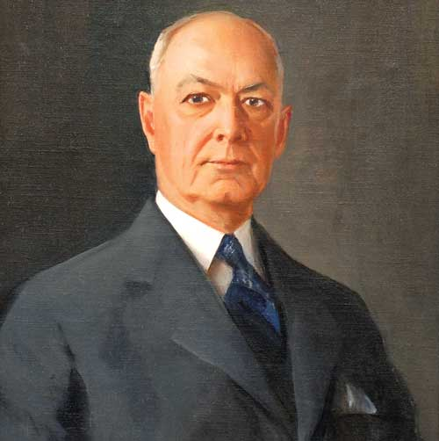
Founded in 1907
by psychiatrist Dr. Arthur Rogers
Our Mission
We provide highly effective mental health and addiction treatment that helps people reach their full potential for health and well-being.
Our Vision
We envision a future where people have the tools to rise above the challenges of mental illness, addiction, and stigma to lead healthy lives. We bring this vision to life by constantly elevating the standard for behavioral healthcare, demonstrating our exceptional treatment outcomes, and acting with compassion and respect.
Our Values
Excellence | Compassion | Accountability

Slide 8
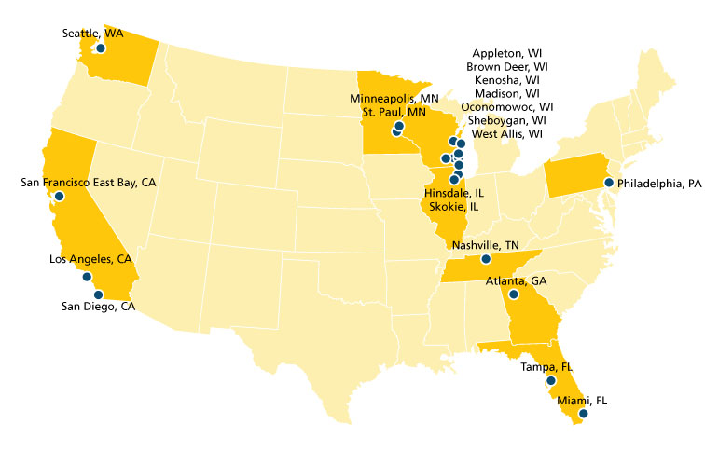
About Rogers Behavioral Health
3 inpatient hospitals
14 residential programs
20 outpatient centers
40⁺ unique partial hospitalization and intensive outpatient programs
2,500⁺ employees
180⁺ medical staff including
100⁺ psychiatrists

Slide 9
What we treat:
22,000+ admissions a year
1,500+ patients each day
OCD and anxiety
Depression
Addiction
Eating disorders
Trauma
Anxiety and depression in autism spectrum disorder
Offer TMS services
20 years of treatment outcomes data from 30,000 patients
1 million patient self-assessments are completed a year
90%+ patients show improvement

Slide 10
Today’s agenda
Why mental health matters and the economic impact
Effect of COVID on Mental Health
Most common conditions in the workplace and how to identify them
What employers can do to maintain a healthy workplace and ensure productivity, retention, and engagement

Slide 11
Why this matters
Mental Health America’s report, Mind the Workplace, states that workplace mental health issues cost companies over $500 BILLION in lost productivity a year.
Major cause of disability, absenteeism, presenteeism, and productivity loss for adults in prime working years.
1 in 5 people experiences mental illness in a given year
Many who need help don’t seek it, despite the fact that treatment is effective.
Impact on health with increased incidence of heart disease, stroke, diabetes, and certain types of cancer

Slide 12
Why this matters: Absenteeism and Lost Productivity
More workers absent from work because of stress and anxiety than because of physical illness or injury.
More days of work loss and work impairment caused by mental illness than many other chronic conditions such as diabetes, asthma, and arthritis.
Employees with depression report productivity levels at 70% of their peak performance.
Depression is estimated to cause 400 MILLION lost workdays each year
In a 3-month period, employees with depression:
miss an average of 4.8 workdays
Have 11.5 days of reduced productivity
Notes:
1 Marlowe JF: Depression’s Surprising Toll on Worker Productivity, Employee Benefits Journal, March 2002.
2 Stewart WF et al: Cost of Lost Productive Work Time Among U.S. Workers with Depression. JAMA June 2003.
3 An Employer’s Guide to Behavioral Health Services, National Business Group on Health, December 2005.

Slide 13
Look beneath the surface
Medical
Mental health/substance use disorders
Pharmacy
Disability
Presenteeism and lost productivity
Absenteeism
Unrealized output
Stress on team members
Overtime to cover sick-day absences Overstaffing
Temporary workers
Recruitment
Hiring costs
Retraining

Slide 14
In any given year…
An estimated 20% of adults experience mental illness.
An estimated 10% of adults had a substance use disorder.
An estimated 5% had both mental illness and substance use disorder.
Depression, anxiety, and substance use disorder: most common among employed populations

Slide 15
And now in a pandemic

Slide 16
The “Second Pandemic”
According to the Wisconsin Department of health -there was already a mental health crisis growing in the Milwaukee area with 5000 more crisis calls recorded in 2019 than in 2015.

Slide 17
“Second Pandemic”
According to the Kaiser Family Foundation 53% of adults in July 2020 reported that COVID negatively affected their mental health
36% trouble sleeping
32% difficulty eating
12% increase substance use
12% worsening existing psychiatric concerns

Slide 18
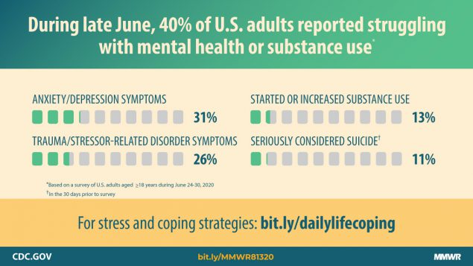
The impact of COVID-19
Per CDC, symptoms of anxiety disorder and depressive disorder increased considerably in the United States during April–June of 2020, compared with the same period in 2019

Slide 19
CDC Household Pulse Survey 2020
Online survey to rapidly respond and provide relevant data
PHQ-2, GAD-2
3 phases
April-July
August – October
October- December

Slide 20
Since COVID
CDC’s Household Pulse Survey suggests that the proportion of US adults with anxiety and or depression has quadrupled with COVID with the burden disproportionately borne by women and people of color
The pulse survey also suggested access to care in the US worsened evidenced by nearly one quarter of adults in early November report that they have not received needed care

Slide 21
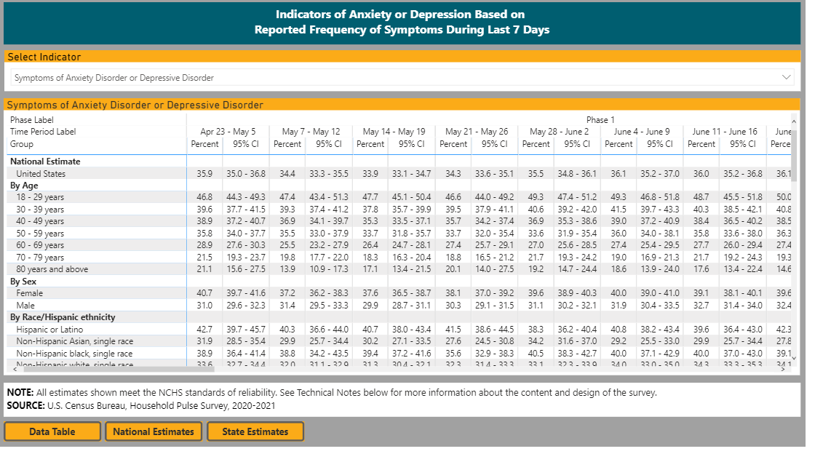

Slide 22
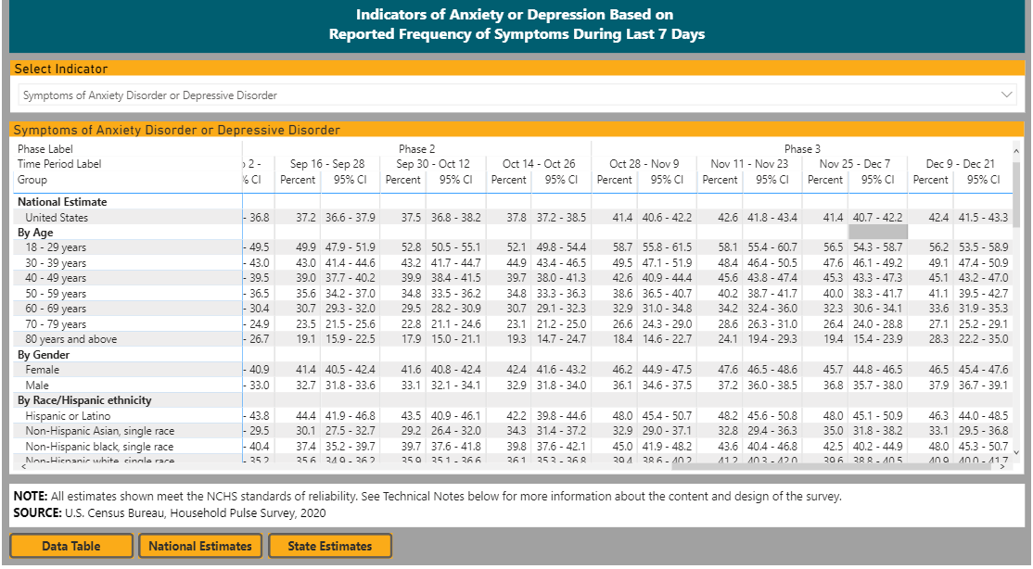

Slide 23
The “Second Pandemic”
COVID has affected the health, safety and wellbeing of individuals and communities
Individuals
Insecurity
Confusion
Emotional and Physical Isolation
Stigma
Communities
Economic loss
Work and school closures
Inadequate resources for medical response
Deficient distribution of necessities

Slide 24
COVID-19 and Psychiatric Treatment access
Some psychiatric treatment closed, some patients refused to attend
Some patients (as above) put off needed care out of fear of groups/ treatment/ hospital
Telemedicine
Access for some types of treatment improved
Some patients refused
Not a great choice for every disorder
Trouble getting to pharmacies
Loss of jobs, insurance, access
Concerns with specific treatments / modalities

Slide 25
What changed at the workplace?
Shut down? Not essential?
In person vs virtual- return to work?
Decreased demand? Layoffs?
Increased workload with peer illnesses
Social Distancing
Masking
Handwashing
Conflict over COVID

Slide 26
Anxiogenic changes with COVID
Loss of job/ paycut
Virtual or in person
Childcare issues with worries about safety of daycare
Health worries
Will I get sick working ?
Will I get my family sick from work?
Masked? Distanced?
Are my workmates or customers masked or distanced enough?
What about my air handler?
Communication?
Short staffed with workers out ill
Restaurants? Bars?

Slide 27
COVID-19 and the workplace
Substantial percentage report increases in depression and anxiety
“Essential” or not – according to Kaiser Family Foundation (12/20)
Essential workers report increased anxiety and depression more frequently (42%-30%)
Essential workers report higher percentages of substance use (25% - 11%)
Essential workers report higher rates of suicidal thoughts (22% - 8%)

Slide 28
Three most common workplace psychiatric disorders
Depression
Anxiety
Substance abuse

Slide 29
Depression
Mood disorders are the most common cause of hospitalization for all people in the U.S. under age 45 (after excluding hospitalization related to pregnancy and birth).
More than 17 million U.S. adults had at least one major depressive episode in the past year.
Depression, bipolar disorder, and other mood disorders are the leading cause of disability worldwide for both males and females.

Slide 30
How depression presents at work
Withdrawal from team, isolates oneself
Indifference
Putting things off, missed deadlines, accidents
Seems “scattered” or absentminded
Procrastination, indecisiveness, slowed productivity
Late to work, afternoon fatigue, accidents
Unsure of abilities, lack of confidence
Low motivation, detached
Inappropriate reactions, strained relationships
Change in appearance

Slide 31
Suicide in the U.S.
8th leading cause of death
More years of life are lost to suicide than any other single cause except heart disease and cancer
30,000 Americans die by suicide each year; an additional 500,000 attempt suicide annually
Eight out of ten people considering suicide give some sign of their intentions
Notes:
Mental Health America 2019

Slide 32
Addiction
Nearly 20 million Americans age 12 and older battled a substance use disorder in 2017.
Almost 74% suffering from a substance use disorder struggled with addiction to alcohol.
11.2% struggled with an illicit substance use disorder.
1 out of every 8 suffered both alcohol and drug use disorders simultaneously.
3.4% of all adults struggled with both a mental health disorder and a substance use disorder (co-occurring disorders).

Slide 33
How addiction presents at work
Frequently missing days of work, typically without providing any advanced notice
Multiple sick days without providing a doctor’s note
Disappearing for periods of time and excessive trips to the bathroom
Constantly being unprepared, forgetting appointments, and missing deadlines
Changes in work performance, such as a decrease in quality of work; increase in the time for simple tasks
Frequent accidents or injuries
Poor memory and inability to focus
Conflicts with other employees
Erratic or aggressive behavior
Poor hygiene
Changes in mood and personality
Secrecy and isolation
Errors in judgement

Slide 34
Anxiety
Anxiety disorders are the most common mental illness in the U.S., affecting 18.1% of the adult population each year.
Nearly 31% of adults will have an anxiety disorder within their lifetime.
Generalized anxiety disorder affects 6.8 million adults; women twice as likely
Panic disorder affects 6 million adults with women twice as likely
Social anxiety disorder affects 15 million adults; typically begins around age 13.
PTSD affects 7.7 million adults with women more likely to be affected than men.

Slide 35
How anxiety presents at work and underlying causes
Taking an unusual amount of time off work
Overreacting to situations on the job
Focusing too much on negative aspects of their job
Struggling to concentrate or complete tasks by the deadline
What can cause anxiety in the workplace
Dealing with workplace bullying or conflicts with coworkers
Meeting deadlines
Managing staff
Working long hours and experiencing a heavy workload
Having a low reward (not enough pay, benefits, etc.)
Having a demanding or ineffective boss
Lack of clear direction
Perception of being treated unfairly
Loss of control over the work environment

Slide 36
Many don’t get help
60% of adults with mental illness didn’t receive mental health services in previous year.
People often suffer for years before getting treated; typically a decade or more of delays – during which time additional problems develop.
Employees with untreated mental illnesses who go to work do so with an illness that impairs them physically, mentally, and emotionally.

Slide 37
Reasons for NOT getting treatment
Inability to afford the cost of care (55%)
Not knowing where to go for services (26%)
Believing at the time that the problem could be handled without treatment (25%)
Not having the time to go for care (15%)
Concerned about confidentiality (11%)
Might have negative effect on job (9%)
Notes:
Receipt of Services for Behavioral Health Problems: Results from the 2014 National Survey on Drug Use and Health
Authors
SAMHSA: Beth Han, Sarra L. Hedden, and Rachel Lipari; RTI International: Elizabeth A. P. Copello and Larry A. Kroutil
http://www.samhsa.gov/data/sites/default/files/NSDUH-DR-FRR3-2014/NSDUH-DR-FRR3-2014/NSDUH-DR-FRR3-2014.htm
Lack of care seeking
Any mental illness (AMI)
Among the 3.4 million adults aged 18 or older in 2013 with AMI who had a perceived unmet need for mental health care and did not receive mental health services in the past year, several reasons were reported for not receiving mental health services. These included an inability to afford the cost of care (55.3 percent), not knowing where to go for services (25.5 percent), believing at the time that the problem could be handled without treatment (24.6 percent), and not having the time to go for care (14.8 percent), concerned about confidentiality (10.7 percent), might have negative effect on job (8.7 percent) [SAMSHA, 2014]

Slide 38
Treatment works
Well-established that mental health and addiction disorders are treatable conditions. For most disorders, there are a range of treatment methods with proven efficacy.
Pharmacological: psychotropic medications.
Psychosocial: psychotherapy, intensive outpatient for substance use disorders
With appropriate diagnosis, treatment and monitoring, approximately 80% of individuals with depression will recover fully.
Clinical pathway: Inpatient, Residential, Outpatient (PHP and IOP)
Notes:
US Department of Health and Human Services. Mental Health: A Report of the Surgeon General, 1999
National Institute of Mental Health. Depression: A treatable illness. 2004.
Prien & Kupfer, 1986; Thase, 1993

Slide 39
Treatment improves performance
Nearly 86% of employees treated for depression report improved work performance.
80% of those treated for mental illness report “high levels of work efficacy and satisfaction.”
Treatment of depression results about a 40-60% reduction in absenteeism/presenteeism.
Notes:
Finkelstein SN et al: Improvement in Subjective Work Performance after Treatment of Chronic Depression: Psychopharmacology Bulletin, vol. 32, 1996, pp. 33-40.
Therapy in America 2004: Poll Shows Mental Health Treatment Goes Mainstream.
Dunlop, DD Am J Pub Health 2005. Wang, PS Am J Psych 2004. Simon, GE Gen Hosp Psych 2000. Claxton, AJ JOEM, 1999.

Slide 40
What employers can do
Encourage employees to get treatment and make it easy to do so.
Raise awareness:
Educate employees and managers about mental health conditions, including depression, and encourage employees to seek help when needed.
Integrate mental health information into health communication. Include content in company newsletters, on the intranet and in other regular employee communication platforms.
Promote early recognition of symptoms

Slide 41
What employers can do: use your role to promote a healthy culture
Reduce the stigma surrounding mental health conditions.
Mental health remains a taboo topic so train supervisors and employees on how to start a conversation if they are concerned about an employee.
Talk about mental health, especially from the top.
Include mental health messages whenever you talk about health.
Counter stigma with educational campaigns and anti-stigma initiatives.
Lead by example, especially with good mental health practices.
Notes:
3 World Health Organization. The Global Burden of Disease: 2004 Update. Geneva, Switzerland: WHO Press, World Health Organization; 2008:160.http://www.who.int/healthinfo/global_burden_disease/2004_report_update/en/. Accessed February 2, 2014.
4 Merikangas KR, Ames M, Cui L, et al. The impact of comorbidity of mental and physical conditions on role disability in the US adult household population. Arch Gen Psychiatry. 2007;64(10):1180–1188. PubMed doi:10.1001/archpsyc.64.10.1180 Show Abstract
Pratt LA, Brody DJ. Depression in the United States household population, 2005-2006.
National Center for Health Statistics: NCHS Data Brief No. 7; 2008. Available from: http://www.cdc.gov/nchs/data/databriefs/db07.htm#ref08

Slide 42
Workplace mental health
Employers Influence:
Benefit coverage and design (medical, MH/SUD, Rx)
Vendors of health, wellness, (external) EAP and disability insurance
EAP, wellness, occupational and other worksite programs
Implementation of laws (ADA, MHPAEA, FMLA)
Reimbursement policy (value-based purchasing, medical homes)
Healthcare Quality
Stigma (culture of health, support for help-seeking, increase awareness)

Slide 43
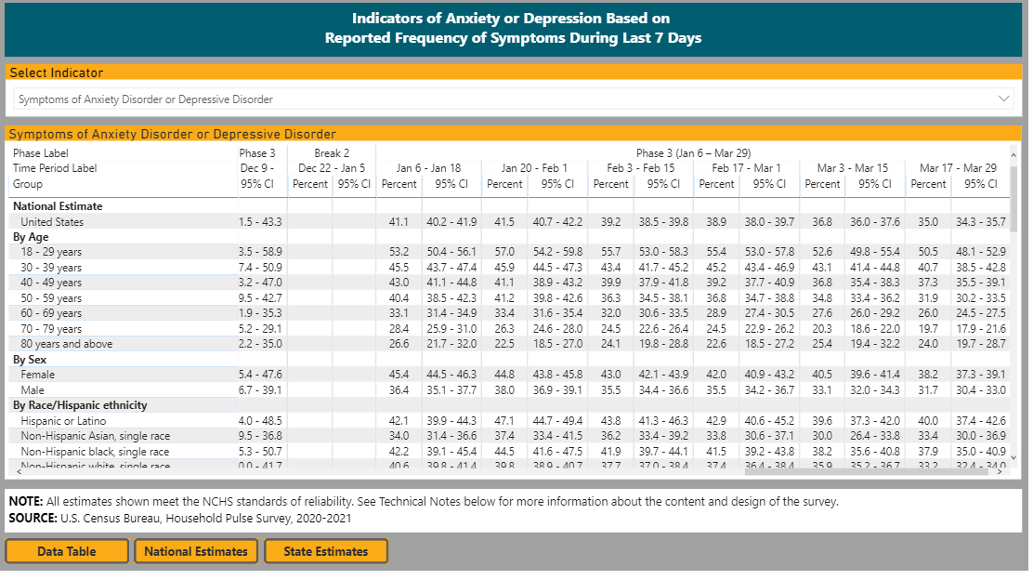

Slide 44
Resources
Resources: American Psychiatric Association Foundation Center for Workplace Mental Health
Rogersbh.org and Rogersbh.org/Resources
For employees:
Where to go for help
Up to Me, Safe Person, and Compassion Resilience initiatives at wisewisconsin.org
What to say handout and not to say

Slide 45
Thank you
Send questions to Jerry Halverson, MD, FACPsych, DFAPA
Jerry.halverson@rogersbh.org
262-646-1075

Slide 46
Moderator & Employer Panel
Melina Kambitsi, Ph.D.
Julie Norland
Diana Clark
Sr. Vice President, Business Development & Strategic Marketing
SPHR, SHRM-SCP, MRA
Benefits Manager, Promega Corporation

Slide 47
Thank You
info@the-alliance.org
www.the-alliance.org

